Slide 1
Inherent Threats
Adam Shostack
adam@shostack.org
infosec.exchange/@adamshostack

Slide 2
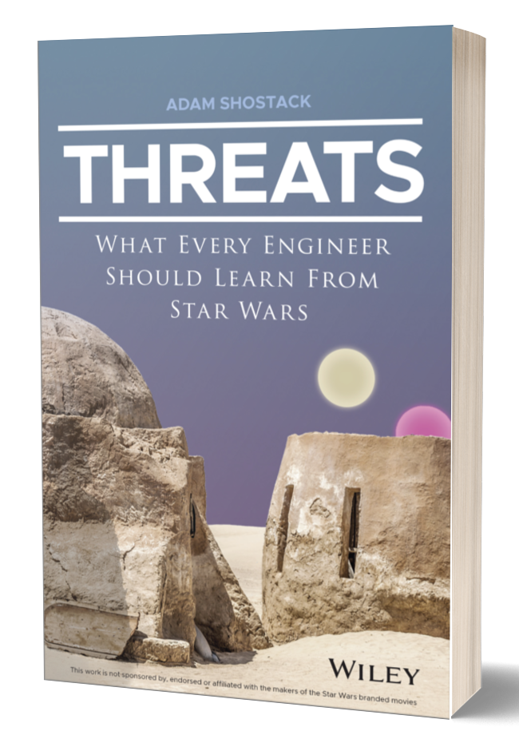
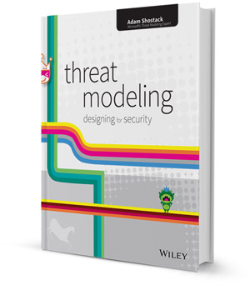
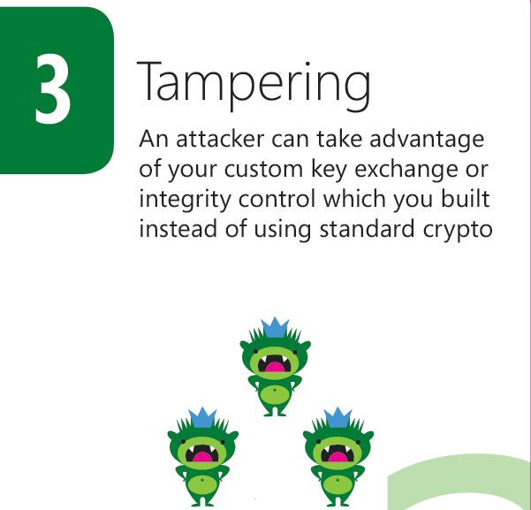
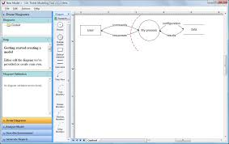
About Adam Shostack

Slide 4
Inherent threats getting on a boat
Getting wet
Getting seasick
Falling overboard
Boat sinks
The lawyers insist that this list for ILLUSTRATIVE PURPOSES ONLY, and you should figure it out for yourself
Notes:
All of these inherent to being on a boat

Slide 5
“What are we going to do about it?”
Easy to address
Hard to address
Lock your S3 bucket
Use a local temp directory
Use prepared statements
Authentication
Usability
Falling out of a boat
… Require vigilance, investment
… Risk acceptance!

Slide 6
Training courses got derailed
People got tripped up by divergent answers
Why is this one easy and this one hard?
“What are we going to do about it” goes sideways
People are really confused because “it” isn’t one thing

Slide 7
Summary
Some threats are more inherent than others
Awareness lets us anticipate which ones will be hard to address
Thinking about inherent threats illustrates how to scale

Slide 8
How this talk will unfold
Definitions
Understanding inherent threats
Addressing inherent threats
How inherent threats help you scale threat modeling

Slide 9
Definitions

Slide 10
Definitions
Inherent: existing in something as a permanent, essential, or characteristic attribute: any form of mountaineering has its inherent dangers
Intrinsic: Belonging naturally
Essential: Can’t be removed without fundamentally altering

Slide 11
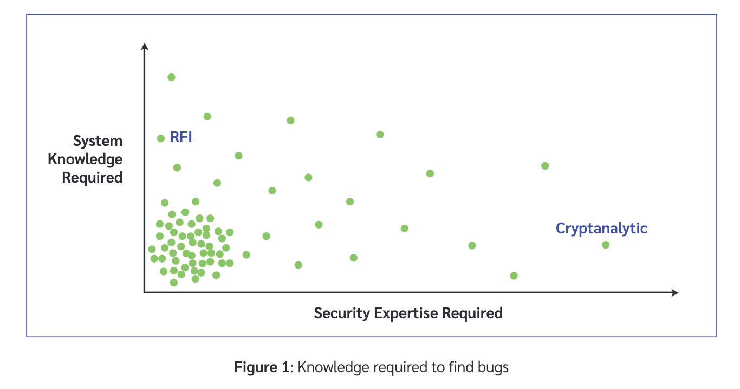
Many vulns are obvious when you look
Path traversal
SQL Injection
Low system knowledge, low sec expertise vulns are why bug bounties work

Slide 12
Many threats are obvious when you look
The same logic applies
Security experts sometimes deride these as “trivial”
Don’t get to strut our stuff
No blackhat talk! 🤯
Attackers don’t care:
They’re probably easy to exploit
These can dominate threat modeling sessions
A good argument for teaching developers
See Jamie Dicken’s RSA talk (“We taught developers to threat model”)

Slide 13
Spectrum
These are not perfectly distinct categories
(“All models are wrong, some models are useful”)
What’s more: issues can ossify and move to the right

Slide 14
Tradeoffs
Authentication
Usability
Machine learning: false positives/false negatives
Combability

Slide 15
Inherent
Bank apps transfer money
Connectivity carries threats
Systems with confidential data can leak it
Systems with value can have it stolen
Social software has social conflict
Obviously Twitter, Facebook
Reviews: Amazon, Yelp

Slide 16
A ship in harbor is safe —
but that’s not
what ships are for

Slide 17
Addressing inherent threats

Slide 18
Types of controls
Accidental threats can often be prevented
Tradeoffs are informed by detection
“Wait and see” (requires seeing!)
You might have a plan but it has downsides
You might have a bag of tricks
Inherent leads to both:
Technical controls for detection and response
Business risk acceptance

Slide 19
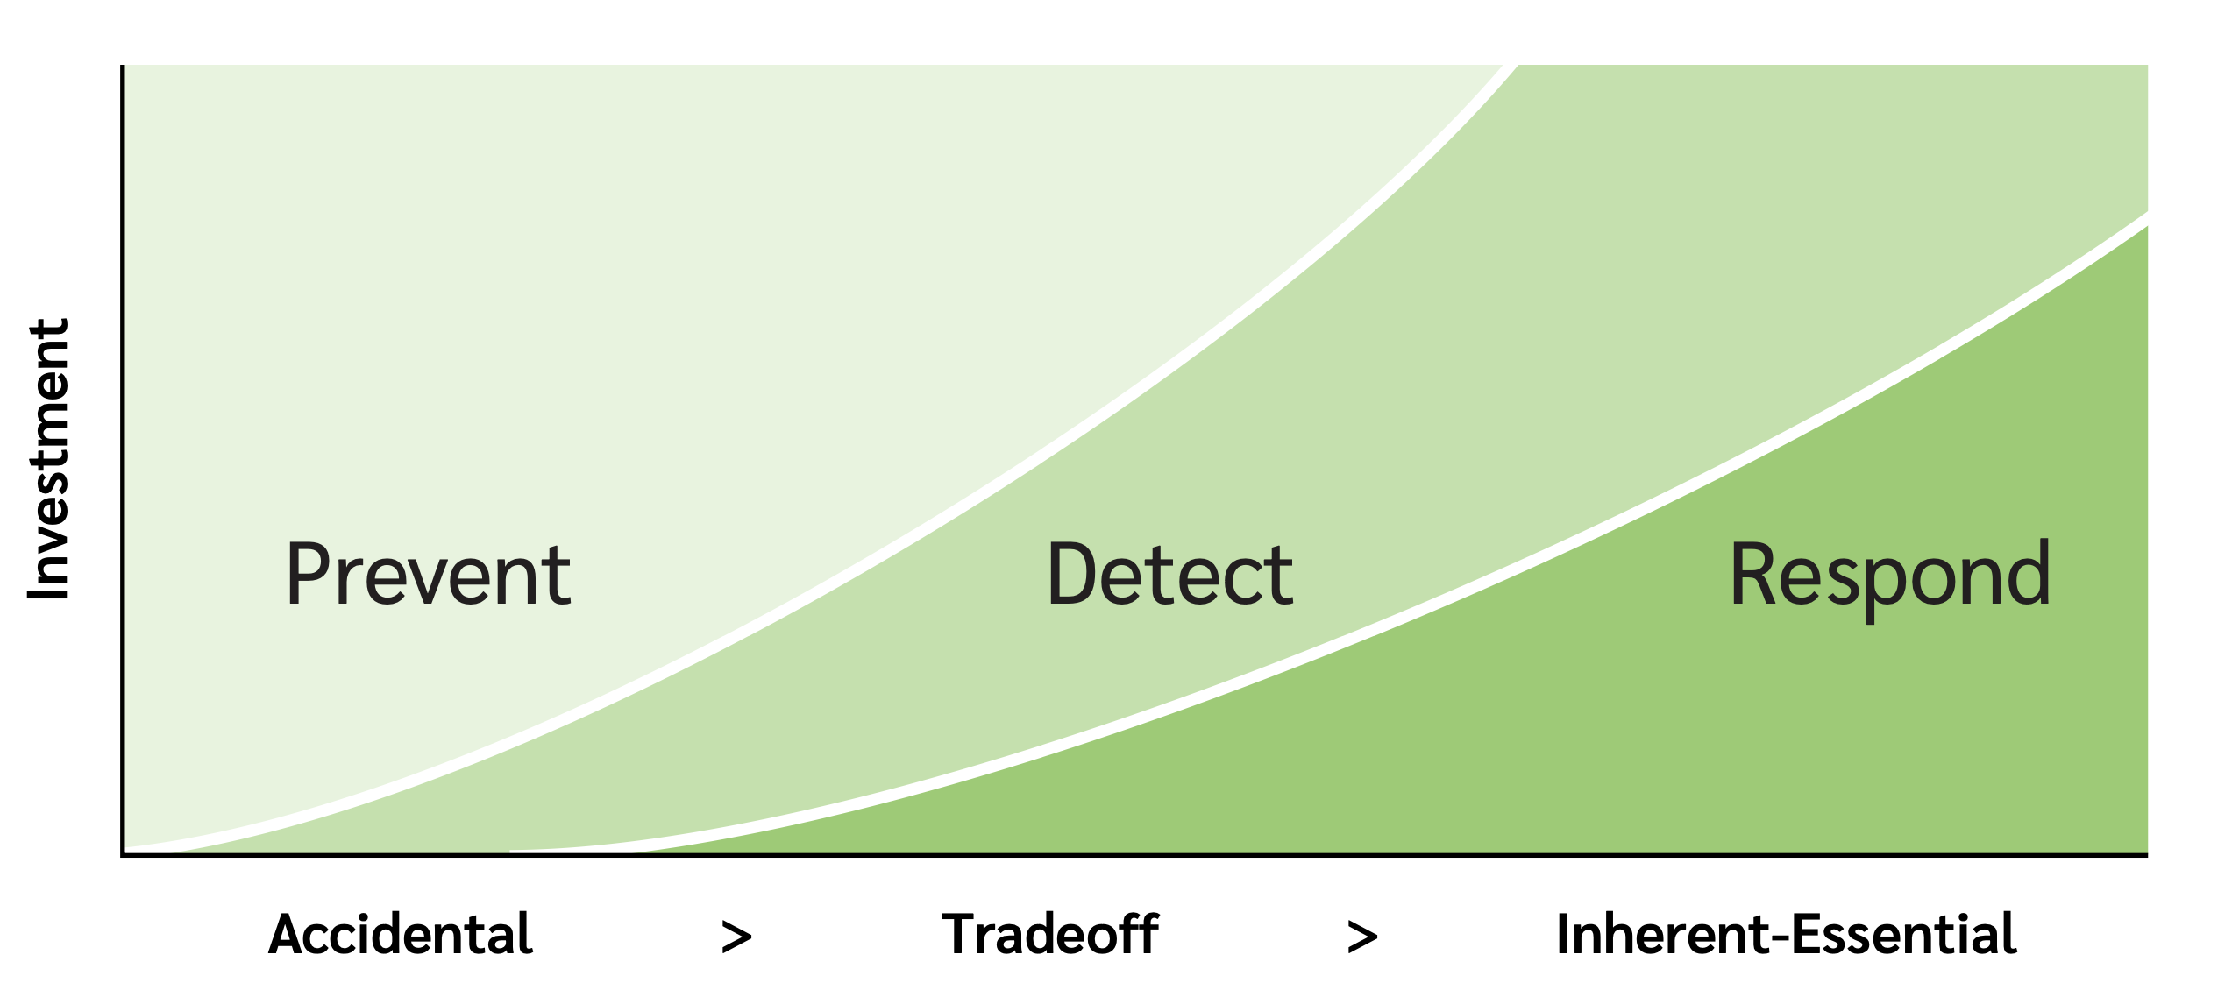

Slide 20
Balancing security and business
Businesses take risks all the time, from tactical to strategic
Inherent threats may require risk acceptance
The “compatibility” tradeoff is predictable
Your APIs, file formats, message formats + protocols
Ensuring good threat modeling here has dramatic payoff
Not threat modeling effectively leads to years of pain

Slide 21
Scaling threat modeling

Slide 22
Really simple models are great
Untested startup
Complex system -> complex model?
No!
Modeling is about abstraction
Great models let you see crucial details?
Great models focus our attention on crucial details!
Secrets
Their LLM
Us

Slide 23
Side note: Great models
Again, great models focus our attention on crucial details
It’s easy to conflate model complexity with quality
It’s easy to conflate model depth with quality
We spend a lot of time teaching people to value utility
“Some models are useful”

Slide 24
Real example: Shostack + Associates
SaaS providers (mutually distrustful)
Course delivery
Staff
Thinkific LMS
Customers
Hubspot
Slack
Zoom

Slide 25
Application inventory
One really simple model per app
Only the inherent threats
Accidental threats make it easy to exploit inherent threats
Staff
Perf reviews
HR DB
Raises
Staff
Perf reviews
HR DB
Raises

Slide 26
Thresholds for deeper investigation
Steal money
Steal high value data
Personally sensitive, corporate/partner secrets
Break the business
Ransomware is a great business model — but dumb
Imagine low, slow tampering

Slide 27
Deeper investigation driven by threats
Previous slide shows availability, confidentiality and integrity
Non-repudiation is also important, authN + authZ support these properties
Classic STRIDE threats matter deeply
These are like “risk” but not quantified

Slide 28
Simple models enable inclusivity
“Even your executives” can understand and participate
The Four Question Framework is an inclusive language

Slide 29
Scale threat modeling via inherent threats
These fast models can get a grip on the key business
For many apps, no one can draw even a simple model
How can you secure things you don’t understand?

Slide 30
Summary
Some threats are more inherent than others
Awareness lets us anticipate which ones will be hard to address
Thinking about inherent threats illustrates how to scale
Free whitepaper at shostack.org/whitepapers

Slide 31
Thank you!

Slide 32
Questions?
Now or
adam@shostack.org

