Slide 1
Diving into Cyber-Physical Resilience
August 2024

Slide 2
Bolster Operational Excellence
Adam Shostack
https://rsvp.withgoogle.com/events/google-health-symposium-2024

Slide 3
Disclaimers
This is not a Google deck but Adam’s slides were integrated into a single presentation.
The event was under the Chatham House Rule. Adam is choosing to release his slides to enable discussion. You’re free to refer to and discuss these slides, but the Rule still applies to everything else.

Slide 4
Improve Observability
Architecture
Design for logging, analysis, breach and other aspects of observability
Effective threat modeling
Communicate architecture and share responsibility models
Consensus about sharing
Publish threat models (“A picture is worth a thousand words”)
Multiple analytic techniques (STRIDE, DIE, Kill chains)
(Not a road map, but attackers are doing fine without road maps)
Increase types of sharing
“This barrier helped”, “we were unable to see here”, “recovery was hard here”

Slide 5
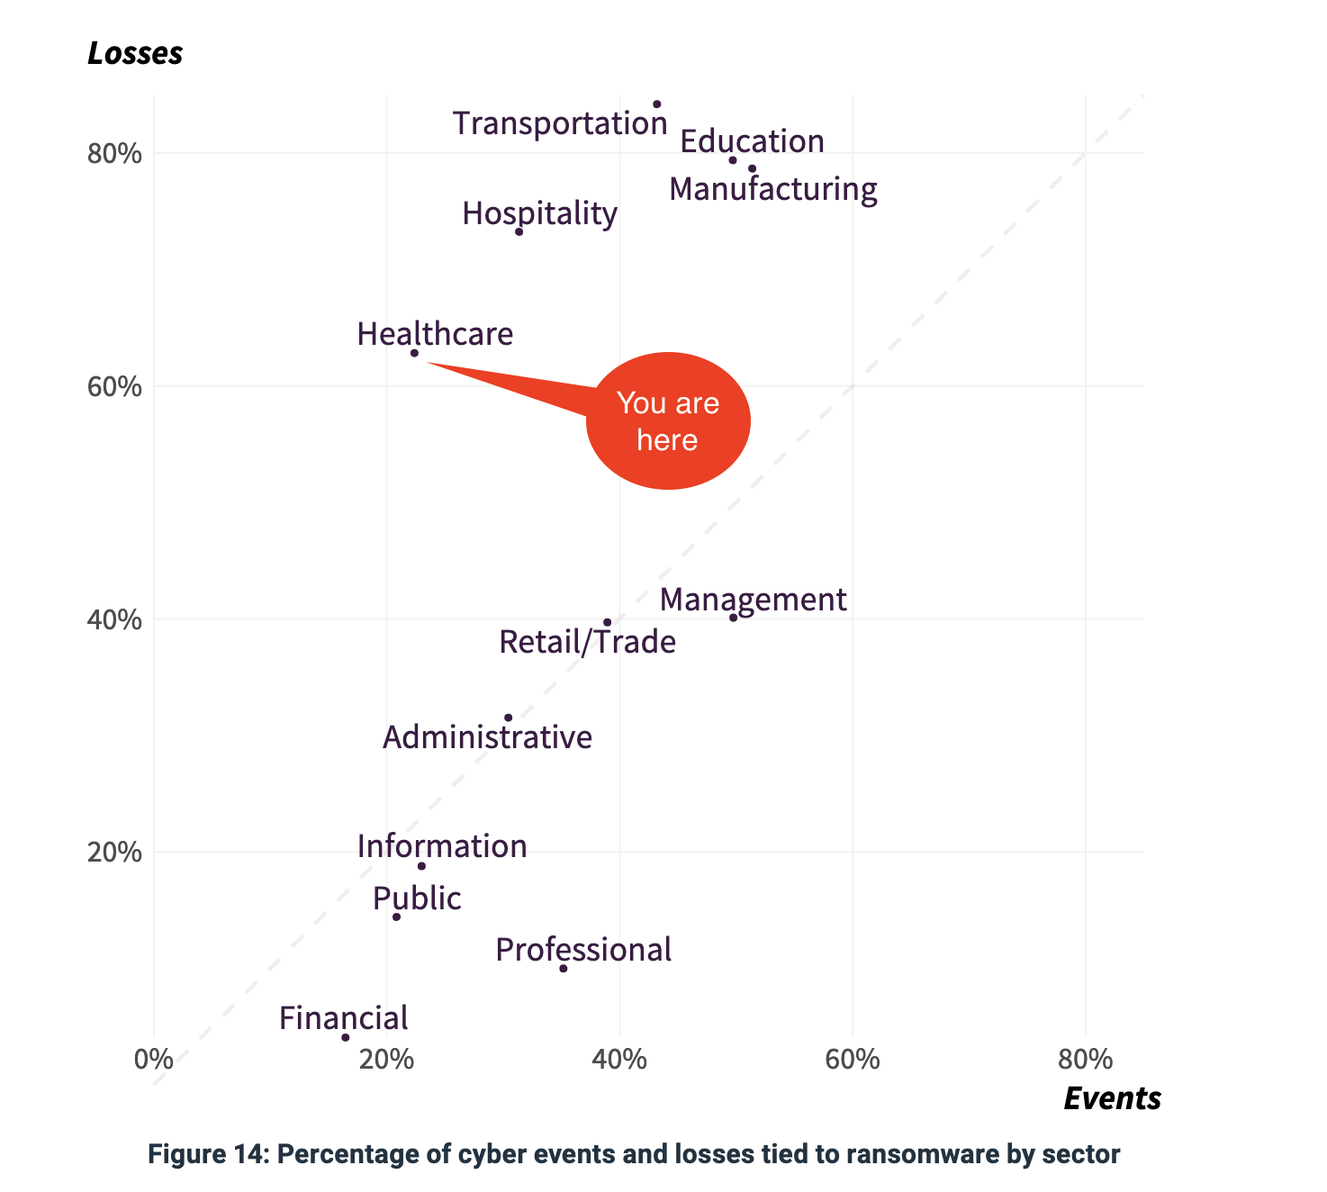
Observability and Fair Measurement Empowers Everyone
How are we doing compared to our peers?
How are we doing compared to 5 years ago?
How is healthcare doing compared to other sectors?

Slide 6
Proprietary + Confidential
Bolster Operational Excellence
Useful measurement to inform strategy
1
2
3
What outcomes are most common? Most impactful?
What population (“denominator”)?
Can we use this data to inform HHS incentive strategy?

Slide 7
Proprietary + Confidential
Bolster Operational Excellence
Public health offers an important model
Focus on “when people die” is clearly “understand what matters”
Find and address the causes of death
Compare + contrast: “Are you compliant with DE.AE-2 to level 3?
Inaugural Workshop on Cyber Public Health (Jan, 2024)
Hosted by Google, CyberGreen Institute
Report now available: cybergreen.net/research

Slide 8
A public health view of operations
Data Gathering
Including defining, refining reportable harms
Can we evaluate, augment or replace current requirements?
Improved sharing reporting about what we’re doing, what’s not working
Appropriate incentives protections, use limits
Reportable diseases as a model
Institutional analysis and publication of analysis, recommendations

Slide 9
Driving Policy Improvements
A Bureau of Cyber Public Health Statistics
Bureau of Cyber Statistics is in Solarium Commission report
Scoped to all critical infra sectors
Rules for Reportable Incidents
Published improvements to guidance, recommendations, requirements

Slide 10
Bonus Slide: Challenges
Why gather Cyber Public Health data?
What are the inhibitors?
Cost
Perceived danger

Slide 11
Proprietary + Confidential
Bolster Operational Excellence
Backup: Threat Modeling The “measure twice, cut once” of cybersecurity; supports defensive + resilient
Four simple questions
What are we working on?
What can go wrong?
What are we going to do about it?
Did we do a good job?
Techniques to answer each (eg)
Data flow diagrams
STRIDE, Kill Chains, DIE
Build/add controls, then manage risk
Retrospectives, NSAT

Slide 12
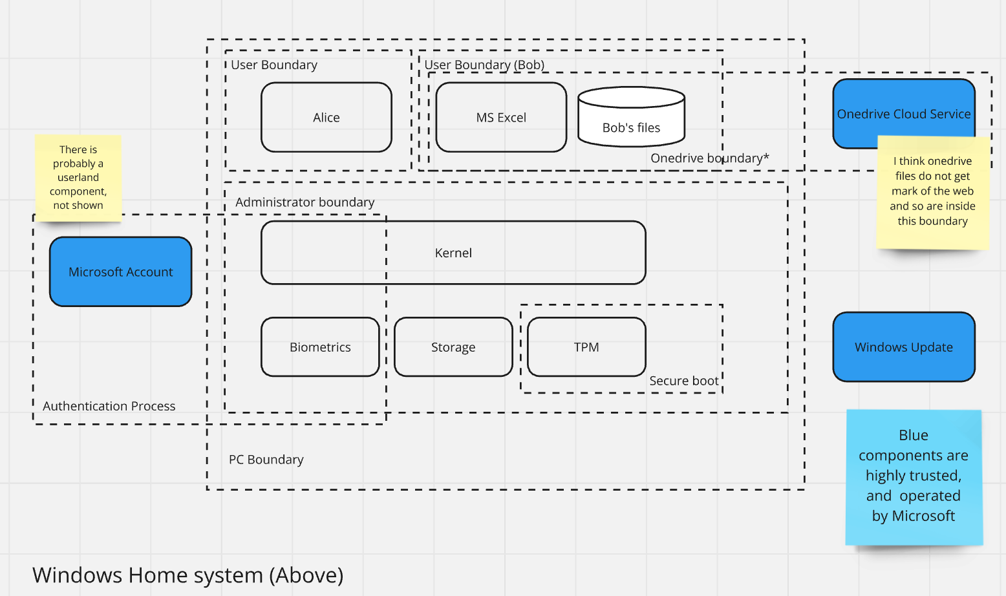
Backup: Publishing Threat Models
Notes:
As marketing beautifies this slide, the distinction between dotted lines and solid lines is semantically important, and the rounded rectangles should stay as rounded rectangles.

