Slide 1
Risk is not a hammer and most hazards aren’t nails
Adam Shostack
Enigma
August 2025

Slide 2
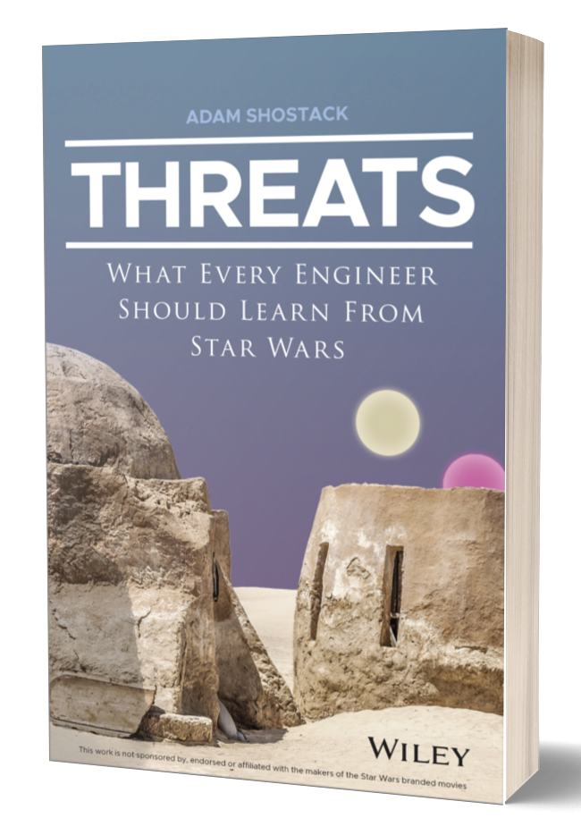
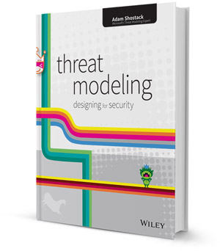



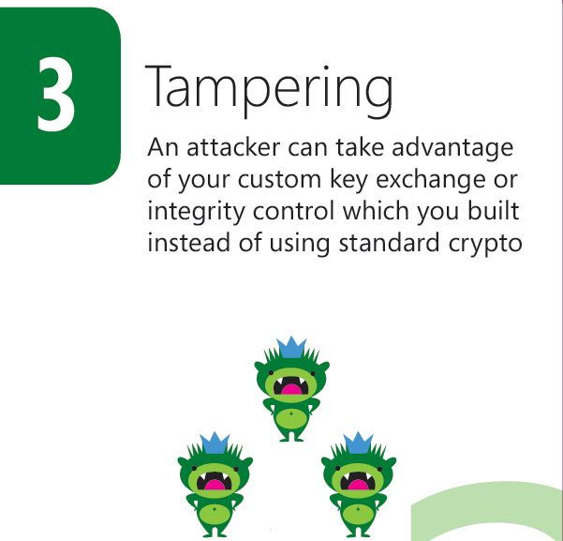
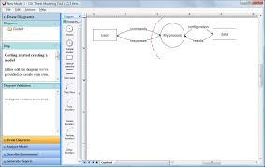

About Adam Shostack
Notes:
Lots of work in threat modeling; S+A Help people threat model, lots of risk conversations, @ microsoft fixed autorun,

Slide 3
Context: Audience polls
Have you ever used risk to quantify a cybersecurity issue?
Did you have the data you needed?
Did the quantification lead directly to a decision?

Slide 4
Thesis statement
People treat risk analysis as a “hammer” which will solve all their cyber problems. (People includes executives, engineers.)
Comments:
“Risk” is also treated as an axiom (unquestionable)
“Risk” does not solve all our problems (or drive all the nails)
This leads to cognitive dissonance ... and research opportunities

Slide 5
Agenda
Risk is used pervasively to define cybersecurity for businesses
Limits of risk quantification
Research implications + opportunities

Slide 6
The word “risk” is used pervasively
NIST CSF opens: “The NIST Cybersecurity Framework provides guidance … to manage cybersecurity risks.”
EU Cyber Resilience Act (2025)
  178 uses across 112 pages!
For this talk, please take it as a given
Risk relates to threat modeling
https://nvlpubs.nist.gov/nistpubs/CSWP/NIST.CSWP.29.pdf
https://eur-lex.europa.eu/eli/reg/2024/2847/oj/eng

Slide 7
What is threat modeling?
Using models to help us think about security
“Threats” meaning possible future problems
The “measure twice, cut once” of security
“You can fix it on the drawing board with an eraser, or on the job site with a sledgehammer” — Frank Lloyd Wright

Slide 8
How do we threat model?
Four Question Framework
  What are we working on?
  What can go wrong?
  What are we going to do about it?
  Did we do a good job?
Threat Modeling Manifesto https://Threatmodelingmanifesto.org

Slide 9
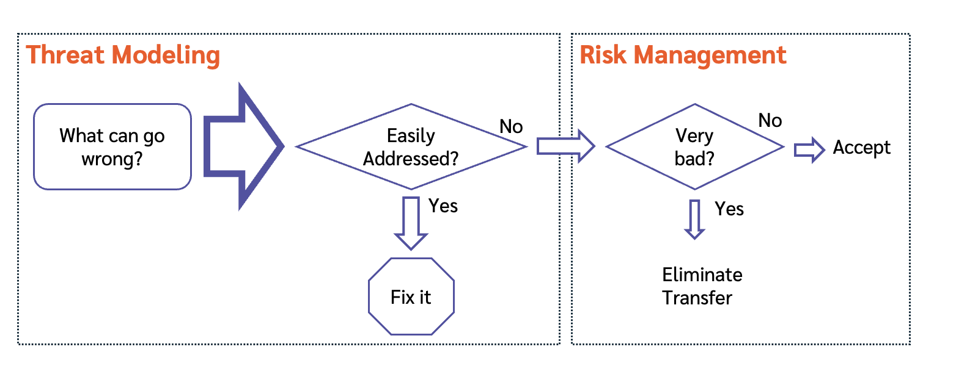
Quantifying a threat produces a risk
https://shostack.org/blog/risk-management-and-threat-modeling/

Slide 10
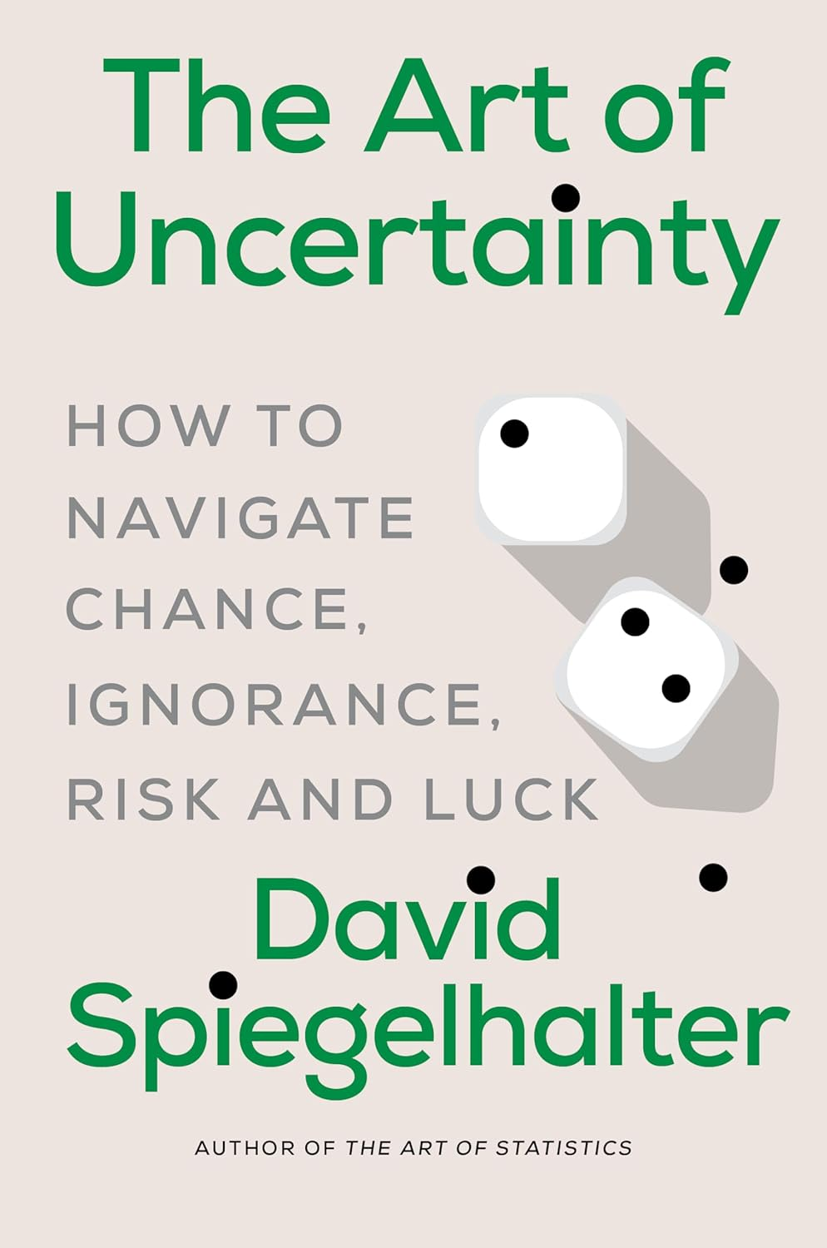
“Risk” means many things
“Risk can mean almost anything you want it to, and in everyday language is often used to describe both a threat (“that broken paving stone is a definite risk”) and the chance of an event (“The risk of falling over is small”).”
(Dr. Speigelhalter is Chair of the Winton Centre for Risk and Evidence Communication in the Centre for Mathematical Sciences at Cambridge)

Slide 11
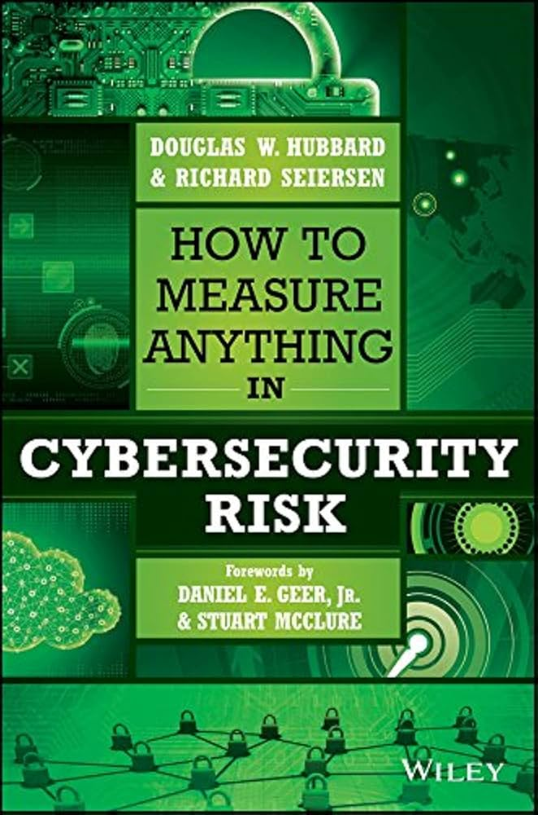
“Risk” is intertwined with “management”
Saying risk evokes
  “measurement”/ “assessment”
  “management”
  “reduction”
  “residual”
Even when the people doing the work know they lack numbers!

Slide 12
This talk focuses on risk quantification
Using “RISK” to mean a quantified/mathematical treatment:
RISK = likelihood × impact
RISK reduction = Risk_{(before)} - Risk_{(after)}
Considering RISK as an input to defender decisions
Putting it in all caps for precision
Not using risk in the broader English sense
  “Defense in depth” isn’t RISK reduction in this sense

Slide 13
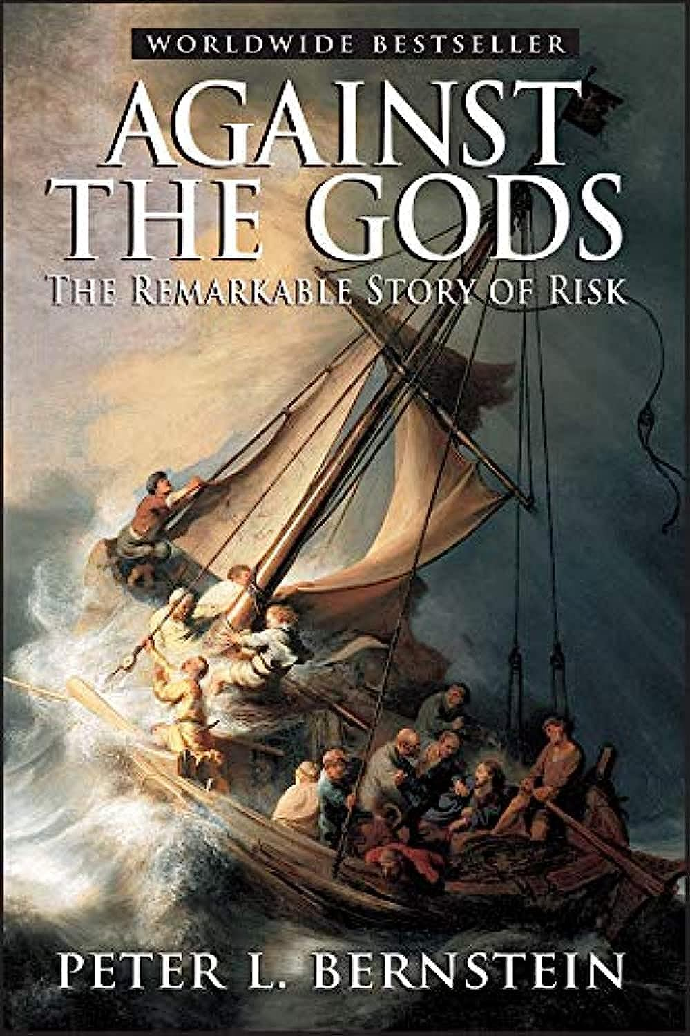
RISK measurement history
Insurance for ships
Gambling!
  Pascal + Fermat and the interrupted game
Annuities/pension plans
Stock portfolios
All of these inform how we think about risk
All of these depend on many iterations

Slide 14
Limits of RISK quantification

Slide 15
RISK depends on iteration, which enables measuring/modeling
Classic approaches to RISK assume repeated chances
Measure/model
  50% of 100 coin flips
  1 in 36 rolls of 2d6
  “Actuarial data”
Let us predict “one in ten” will do X
Let us test if our expectation was reasonable

Slide 16
Applying RISK is empirically hard
Years of observation lead to this talk + investigation
Theories:
Hard to quantify likelihood or impact (thus RISK)
  Relationship between “XSS” and “breach” is non-linear
  Impact data is improving for breaches (Cyentia IRIS)
Business decisions aren’t about RISK
  They’re about making money and deciding between competing investments

Slide 17
Autorun Example of Business Decisions
Autorun was a feature in Windows to run code from newly attached storage
  Widely abused by attackers
  Microsoft had a downloadable fix that changed the behavior, not widely used
2010 I drove the autorun fix to Windows Update
Malicious Software Removal Tool data showed
  ~1M cleans monthly related to autorun
  Roughly one in four to one in three cleans
  Data on impact was ... Less easy
Internal conflict over changing Windows behavior via WU
  No one wants to discourage updating!
  RISK didn’t resolve the debate

Slide 18
Security adversaries may not iterate
If you add a defense, does attacker:
  Bypass?
  Break?
  Use a different vector on you
  Go home
So the sort of iterations of 100 coin flips may not be available
Security adversaries may be “rule free”
  Unlike stock markets, sports betting

Slide 19
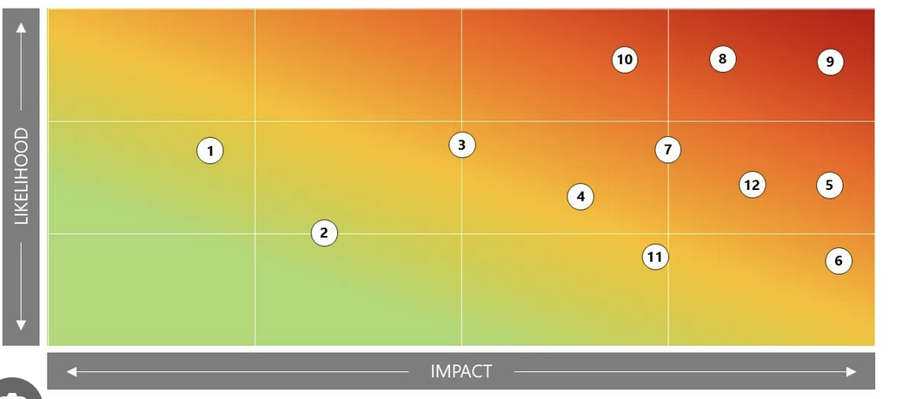
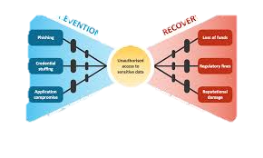
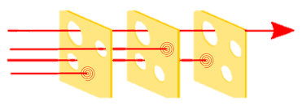
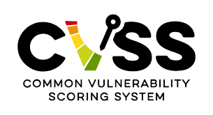
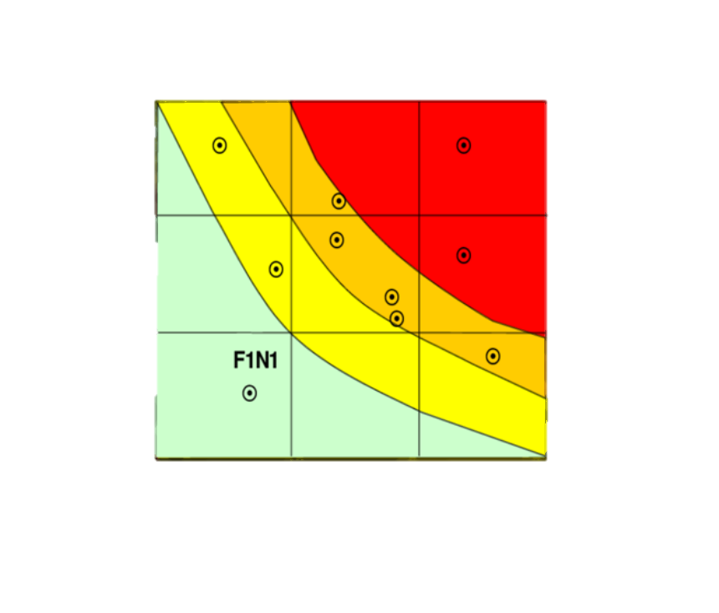
STOP DOING RISK
SINGLE INSTANCES ARE IMPOSSIBLE TO predict!
YEARS OF HEATMAPS yet NO REAL ARGUMENT ever SETTLED
Wanted to pretend for a laugh? We had a tool for that: It was called “GUESSING”
”Yes please give me the odds of Volt Typhoon doing that” — Statements dreamed up by the DeRanged!
LOOK at what RISK has been providing for all this time
THEYY have Played us for absolute fools!

Slide 20
Research Opportunities + Implications

Slide 21
Opportunities
What does the broad risk literature teach for security?
What are the unique properties of cyber that influence how we use RISK concepts?
Could other frames help us more than RISK?
Outcomes: Papers, better practice, better standards
Broad literature
Unique to Cyber
Other frames

Slide 22
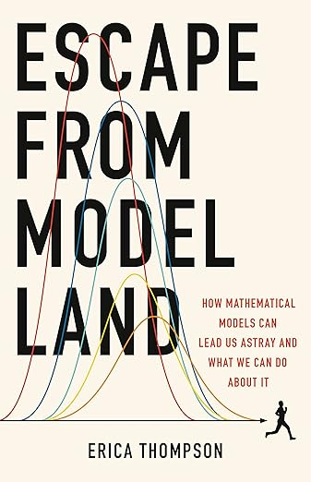
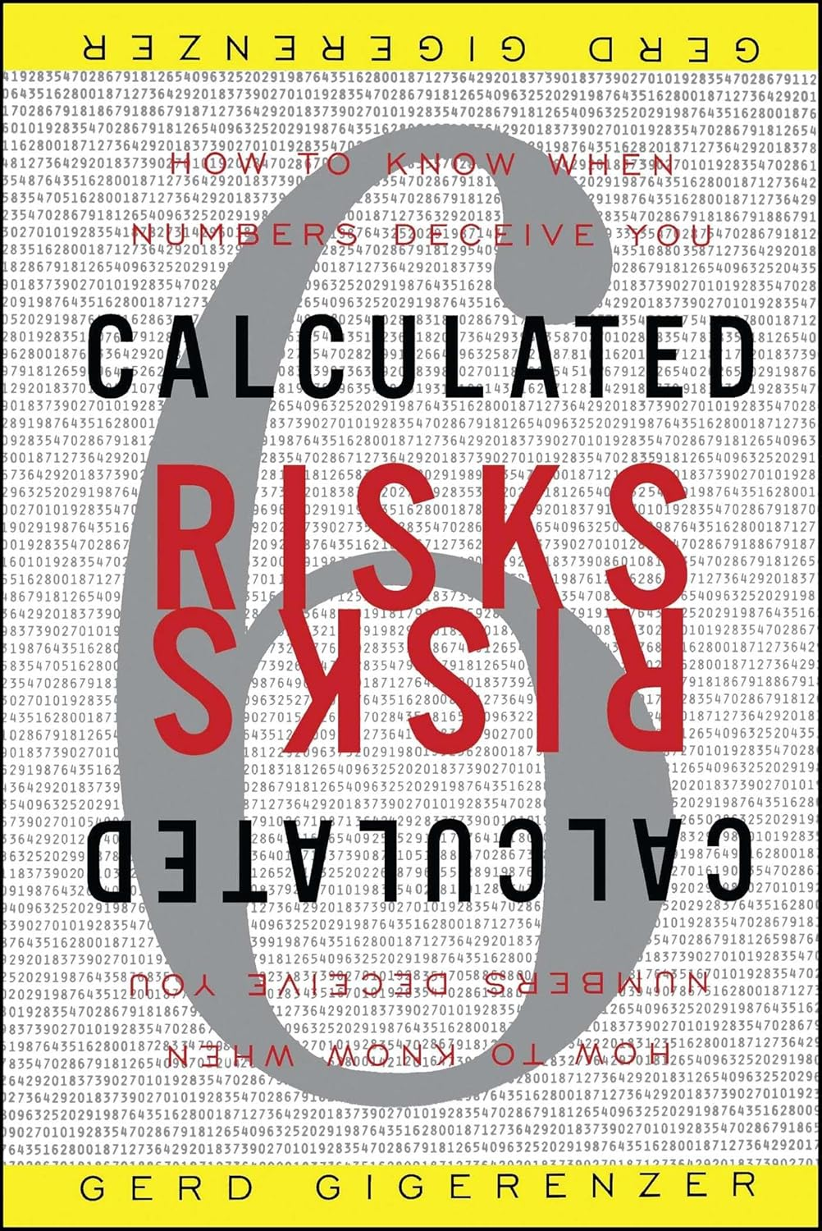
Broad risk literature
The limits of risk as a frame (Speigelahlter, 2025, Thompson 2022)
Limits of risk communication (eg, Gigerenzer, 2003)
How do these known issues apply to cyber?
Broad literature
Unique to Cyber
Other frames

Slide 23
Property: Uncertainty
Kay & King Radical Uncertainty: Decision-making for an Unknowable Future (The Bridge Street Press, 2020), quoted in Simpson, Into the unknown: the need to reframe risk analysis, J Cybersecurity, 14 November, 2024
Inputs that are not known
  Resolvable: Amicable to being looked up
  “Radical uncertainty has many dimensions: obscurity; ignorance; vagueness; ambiguity; ill-defined problems; and a lack of information that in some cases but not all we might hope to rectify at a future date”
Adaptive behavior by attackers seems different than “uncertain”
How does this apply to cybersecurity?
  Where’s the line between vagueness a lack of information?
Broad literature
Unique to Cyber
Other frames

Slide 24
What’s unique about cyber?
Do we have iterations? What are they?
  “Phishing” vs “this email with these defenses”
  What levels of abstraction have what tradeoffs?
What are the theory, applied limits of adversary freedom?
Can we overcome the myriad problems with data gathering, sharing, creating “actuarial data”? (No)
Broad literature
Unique to Cyber
Other frames

Slide 25
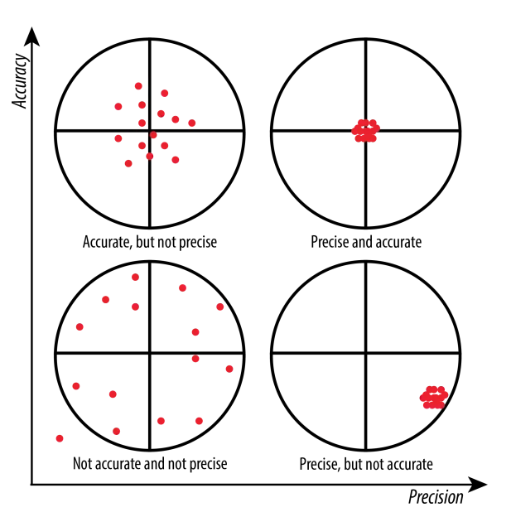
What’s achievable in cyber at what cost?
Unique to Cyber
How much accuracy/precision are needed?
  Accuracy: how close measures are to truth
  Precision: how close they are to each other
What goals are served?
Cost: what does it take to achieve either?
Image from https://wp.stolaf.edu/it/gis-precision-accuracy/

Slide 26
We could measure precision, accuracy
Unique to Cyber
Precision
  Have many people quantify some threat
  Measure reliability (inter-, intra-rate), measure spread
  Can be measured without knowing “the” real value
Accuracy
  Requires(?) iterations
  Every failure gives you data
  Many security failures are very costly
  Near misses give us data (shostack.org/lessons)
But we don’t, and standards don’t set requirements

Slide 27
Property: Defender Cost
Unique Cyber
Effort to produce RISK measurement
Recording the measurement and inputs
Vigorous debate
  (The debate may add value)
Cost of RISK measurement has some “return on investment”
  “Return” may be hard to measure
  “Investment” to calculate is important
  Do we need to spend $1,000 to measure this RISK?
NASA Risk Management Handbook (2014)

Slide 28
Is RISK worth the investment?
Unique Cyber
Many security improvements are not very sensitive to RISK numbers
Other factors dominate the decision
  Cost of fix
  Impact on schedule
  Impact on other features, usability, testability, etc
This can be very frustrating
  Especially because security is told RISK drives prioritization

Slide 29
An approach to evaluating RISK methods
Unique to Cyber
Measure precision + cost?
Seems unsatisfying?
Are we comparing real RISK management systems to aspirational ones?

Slide 30

Other frames may serve us better
Other frames
Engineering
  Building bridges starts with “we need a span with these properties”
  Feynman’s personal appendix to the Challenger report considers RISK
Public health
  Measure outcomes that we want to minimize
  Measure rates (incidence, prevalence)
  Measure interventions
https://shostack.org/
resources/
cyber-public-health
Notes:
Feynman’s personal appendix to the Challenger report considers RISK for space exploration (small # of launches)

Slide 31
Thank you!

Slide 32

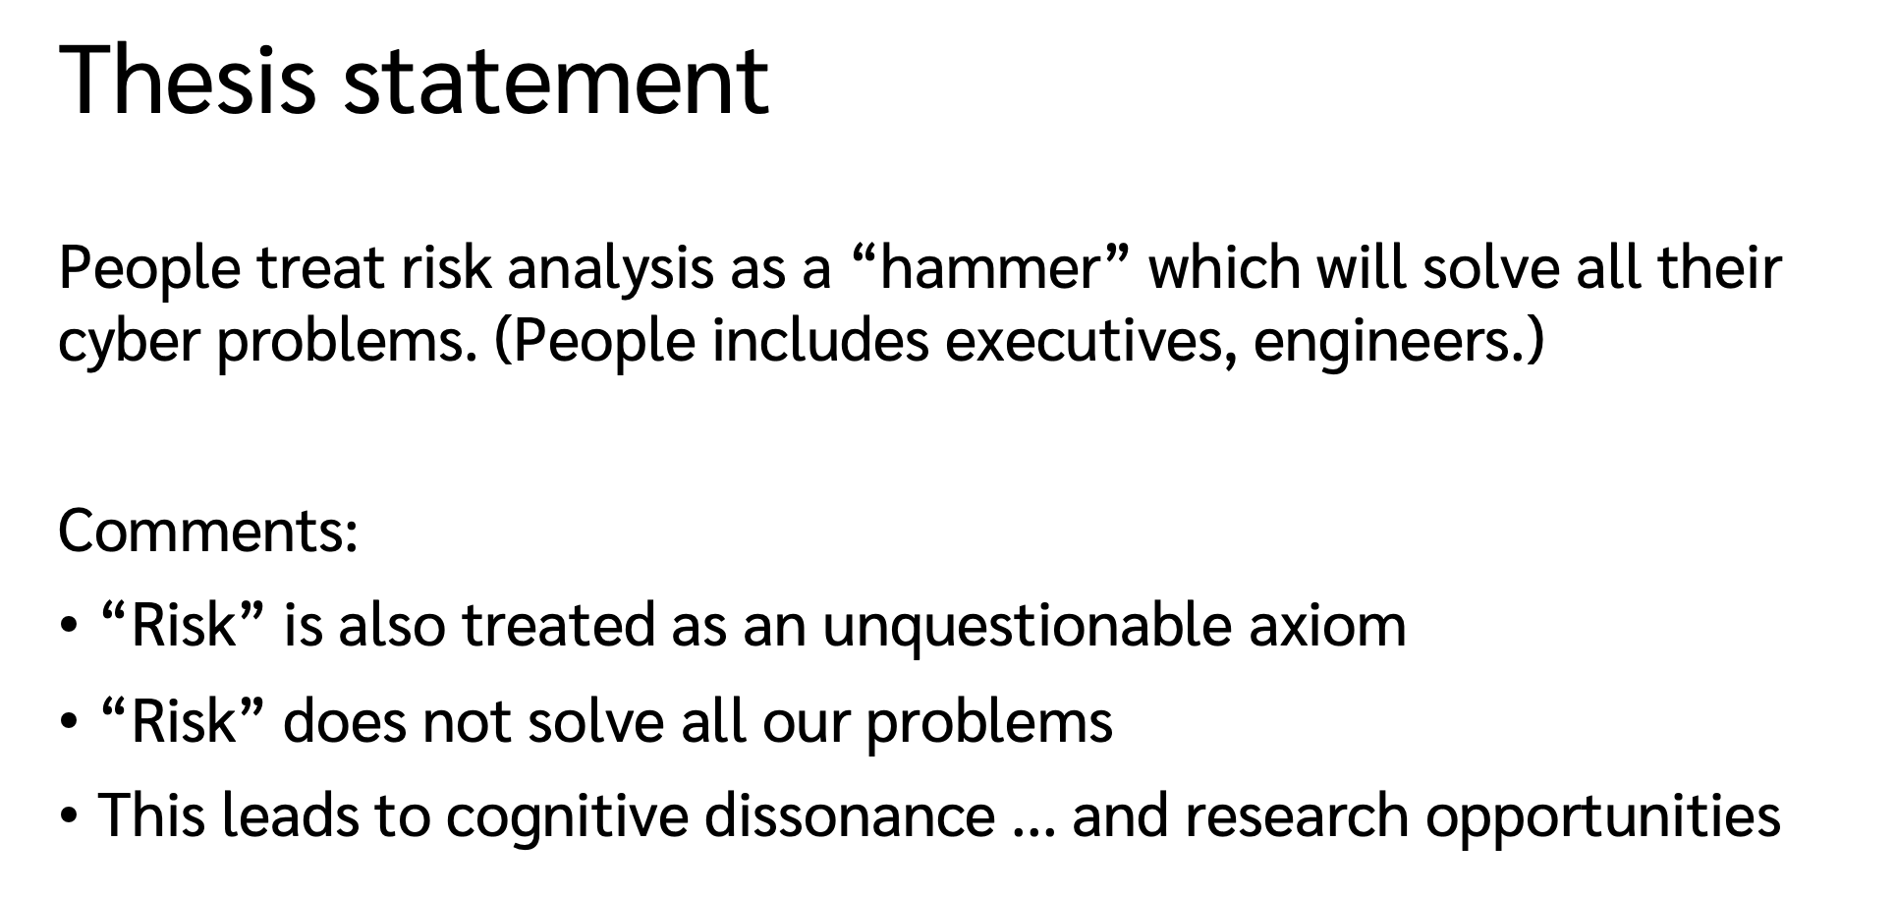

Risk is not a hammer
Adam Shostack, Usenix Enigma, Aug 13, 2025
Questions?
Email me:
adam@Shostack.org
These slides:
Shostack.org/blog

Slide 33

About Adam Shostack

