Slide 1
Towards a Science of Cyber Public Health
Adam Shostack
First Workshop on Cyber Public Health
NYC
Jan 9, 2024

Slide 2
About Adam Shostack

Slide 3
Why?

Slide 4
“Cybersecurity is going great!” “Keep it up folks!”

Slide 5
More seriously
We have no agreed measures of how we’re doing overall
Is security better this year than last?
Many of our measures are tactical (breaches, ransomware payments)
We’re making large investments at individual/enterprise levels
The “cybersecurity” sector is booming
We generally agree we’re not doing well

Slide 6
Fundamental questions
How do security incidents this year compare to last year?
What’s causing them?
Are more incidents about security or population growth?
Are incidents more or less severe?

Slide 7
Project Broad Street: A story from 2010
Assigned to investigate the impact of zero day attacks
Discovered Microsoft had almost no data on causes of infection
Invented some proxies ☺
Also learned Microsoft didn’t have data on # of Windows machines
Focused on “Malicious Software Removal Tool” data

Slide 8
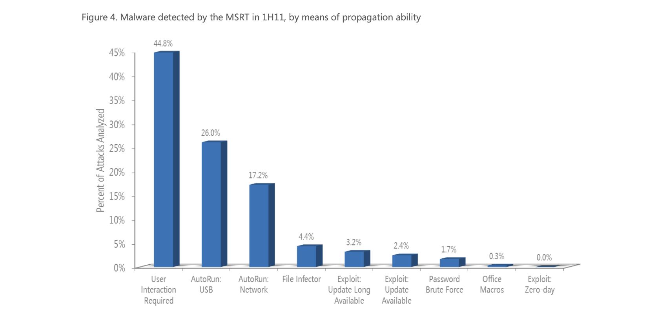
Microsoft Security Intel Report Vol 11

Slide 9
Feb 2011
Security Update 967940 turned off autorun for XP, Vista
MSRT cleans dropped ~25% (1 million cleans/month) for over a year
Today we might say incidence dropped
Still lack data on prevalence of malware
Published the project Broad Street story widely

Slide 10
Example questions we want to answer
How will the Windows 11 hardware requirements impact security?
How many accounts are compromised and not sending spam?
How much ransomware is out there?
Is the National Cyber Security Strategy making us safer?

Slide 11
Public health toolset
Measure important data directly
Vital stats: Births, deaths, causes of death
Harms to people: Disease outbreaks (and more)
Investigate unusual clusters: Find the cause, fix it
Derive statistical information
Incidence, prevalence
Drive policy + behavior change
Improve outcomes

Slide 12
Cyber Public Health
Complements other frames like cyberwar, cybercrime
Leverages proven techniques
Early successes
Metaphors
Heavy use (virus outbreaks, infection, cyber hygiene)
40(+?) years (Virus, Fred Cohen, 1984)
Go beyond the metaphor: Cyber Safety Review Board story

Slide 13
Building Deeper Foundations
With Cybergreen
Internet Infra Health Metrics Framework
Tech reports
Public Health + Cyber Public Health
Vital Statistics
Cyber Belief Model

Slide 14
Going deeper
Today, let’s define challenges
Actively look for success/proof points
What should we achieve in 1, 3 or 5 years? By 2030?

Slide 15
The best way to predict the future is to invent it

Slide 16
Questions?
Now or
adam@shostack.org

Slide 17
Break
10:15-10:45

Slide 18
Section kickoffs

Slide 19
Definitional Challenges

Slide 20
Breakout admin
Table introductions
Roles: facilitator (at easel?), lead note takers
Adam slides are in Drive at ________________________________
10:45 – 12:30 breakout 1: Data
Suggested time division – We’ll advance the slides
10:45 – 11:15 Units
11:15 – 11:45 Harms
11:45 – 12:00 Futures
12 – 12:30 Report out

Slide 21
What are the units of CPH?
What are units in public health?
People (births, deaths, marriage, divorce)
Households, families
Cities and states
Hospitals
What are the cybersecurity equivalents?
Devices, accounts, virtual machines
Enterprises, SMB? (How to think about contractors? Do we need to?)
3. What are the cybersecurity unique units?

Slide 22
What are the harms in CPH?
Public health tracks (examples, not exhaustive)
Disease incidence (New cases in a period), prevalence (# in population)
Quality adjusted life years
Chronic + acute disease
Lifestyle disease
Cyber public health equivalents?
Account takeover, buffer overflow, “Infection” by a virus,
What else?
supply chain attack may be different enough to call unique? Why/why not?

Slide 23
Develop next steps/goals/visions
We need all three
Various levels of resolution, timeline, difficulty
Action items (immediate), stepping stones, milestones, demonstrable wins

Slide 24
Notes
Volunteer notetakers per breakout
Everyone’s encouraged to take notes
We plan to gather your thoughts later
We’ll ask you (at the end of the day) to share essential points
We’ll ask you to share electronically later
Transcribing will trigger other thinking
We hope that revisiting your notes will be rewarding and drive useful results
We’ll have a Google drive set up to share with attendees

Slide 25
Lunch
12:30 – 1:30

Slide 26
Data Challenges
1:30-3:15

Slide 27
Public Health Data
What data does Public Health have, and how did it get it?
Births, death, marriage: all relate to taxes or licenses
Reportable Diseases: obvious benefit, after years of struggle following John Snow, Louis Pasteur
Longitudinal studies (Framingham)
Population studies (British Doctor)
Early wins enabled systematic data capture
Challenges remain:
States not reporting Covid data
“Died of/died with” (real issue, real politics)

Slide 28
What are the CPH data sources?
What are they?
Does it exist today?
Could we get it? (easy, feasible with money, complex, impossible)
Who has it/could get it?
Who might work on it? (Refine, de-dupe, quality, consistency?)
Who can make use of it?
What stops them from getting it today?
Secrecy for business reasons, security reasons (other forms of secrecy?)
What else?

Slide 29
Develop next steps/goals/visions
We need all three
Various levels of resolution, timeline, difficulty
Action items (immediate), stepping stones, milestones, demonstrable wins
Same request: paper notes

Slide 30
Next Steps: The Agenda for maturing Cyber Public Health
3:45 – 5:00

Slide 31
Closing remarks

Slide 32
Immediate next steps
City Winery, downstairs
(Thanks, Google for hosting)

