Slide 2
Threat Modeling: What's Changing & What Comes Next
Adam Shostack
Notes:
Talk track: the first edition of my threat modeling book came out a dozen years ago, and since then, the field has been growing, we’ve been learning and it was time for a new edition.
This talk is going to cover some of the why, and

Slide 3
Website copy
Adam Shostack reflects on more than a decade of progress in the discipline: what we've learned, which practices have stood the test of time, and how threat modeling is evolving to meet the realities of modern software development. Drawing from his upcoming second edition of "Threat Modeling: Designing for Security in an AI World," Adam will share effective approaches to threat modeling in an agile world, working with and threat modeling LLMs, boundaries and diagramming, and other shifts shaping the state of the practice. Attendees will leave with a clearer view of how threat modeling has evolved, where the industry is headed, and what practitioners should be thinking about next.
3:20-3:55

Slide 4
What’s changing:
The commercial world
We have ThreatModCon + TMConnect
We have many companies focused on TM
Threatmodeler, Clearly, DevArmor presenting here today
We have people with TM in job titles
Google alerts for “threat model” are now overwhelming

Slide 5
What’s changing:
The academic world
Academic papers
Data from Cho + Kim, 2025
Papers in 2023 > 2003-1016
Notes:
Thttps://ieeexplore.ieee.org/document/10921707/.

Slide 6
What’s changing:
Regulation
FDA’s Pre-market Guidance for Medical Device Makers
EU Cyber Resilience Act (+NIS2, DORA)
NY Dept. Financial Services
UK Public Sector (UKHSA), telecoms
ISO/IEC 62443, 81001-5-1
Canada OSFI Guideline B-13
...
Notes:
This is a mix of threat modeling requirements, recommendations, and “risk assessment,” all read somewhat broadly, not legal advice.

Slide 7
What’s changing:
Insights from delivering services
Training, Accelerator, TMaaS products
Broad view into what can go wrong in TM practice
All feed into the new edition

Slide 8
Agenda
01 — What are we working on?
02 — What can go wrong?
03 — What are we going to do?

Slide 9
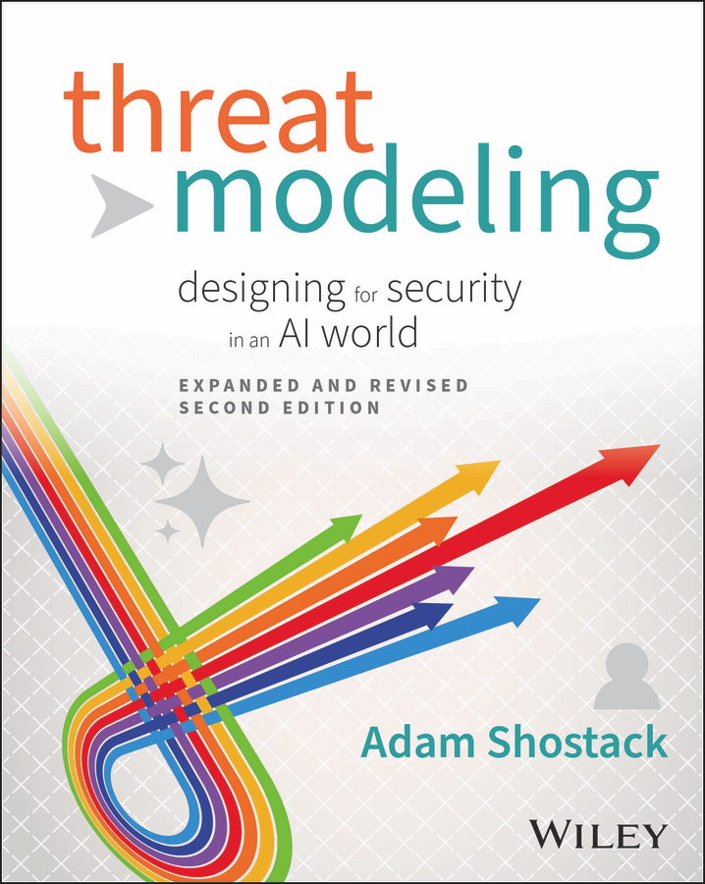
What are we working on?
Expanded + revised edition
50% new
Coming Feb 2, 2027
A chance to reflect on evolution
Notes:
Talk track:

Slide 10
Who’s working on it? Engineers
A fundamental thesis of the book:
Engineering is about tradeoffs —
which must include security
We must build more tools for engineers to use
(Including engineers using LLMs)
Less focus on post-build security analysis/gates

Slide 11
Three types of changes
Practice has changed — here’s what’s happening
Practice should change — here’s why
Example: Trust boundaries
The way we should talk about practice is changing
Lots of “return on investment” lenses

Slide 12
What are we working on?
Part II of the new book
Notes:
New book parts II, III, IV are the Four Questions

Slide 13
When are we working on it?
Before the code or after? (TMs + Reviews)
Same Four Questions, how we answer “what to do” changes
The book is explicit about the before/after versions
Controls how we engage with LLM TM
(Is the TM a constraint or a review?)

Slide 14
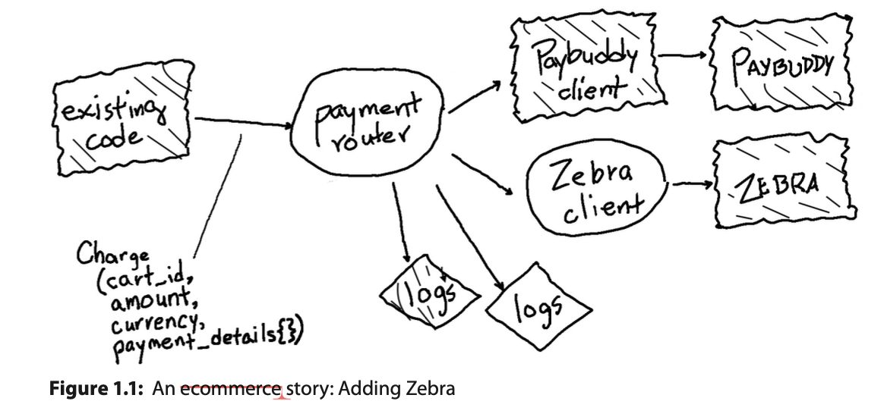
How we work on it? Agile-y
“Working on” smaller chunks
Book is now focused on agile, not waterfall
Hand-drawn diagrams
An Ecommerce story

Slide 15
What’s new: AI
Every chapter has a section “How to use LLMs”
2 chapters on threat modeling of LLMs

Slide 16
Diagrams
New attention on diagrams
Exploratory and explanatory
As-built and as operated

Slide 17
Trust Boundaries
“Trust” is confusing — we see it every time we teach
Boundaries get fuller treatment, including
Boundaries as conceptual
Boundaries as tools for policy
Boundaries as resilient code

Slide 18
What can go wrong?
Part III (of the new book)
Notes:
New book parts II, III, IV are the Four Questions

Slide 19
Attack Lifecycle Models, replace trees
New chapter goes from “threat model project”
To “threat model program”

Slide 20
LLM Threats (Chap 7, 1/2)
PHANTOM-B
MITRE ATLAS
The Berryville Institute’s ARAs
An image-specific taxonomy by Charlotte Bird
Google’s SAIF
NIST’s AIML (which is not their AIRMF)
PROMISE TO MAP

Slide 21
LLM Threats (Chap 7, 2/2)
Google’s empirical misuse list
Meta’s Rule of Two for AI (and why it’s misnamed)
Several approaches to AI red teaming
Scholarly concerns including adversarial perturbation, gradient climbing and model theft

Slide 22
What are we going to do?
Part IV (of the new book)
Notes:
New book parts II, III, IV are the Four Questions

Slide 23
Dramatically reworked
1st edition was infused with Microsoft’s “mitigations” thinking:
The feature would mostly stay
Manage the impact
2nd edition organizes a much broader view

Slide 24
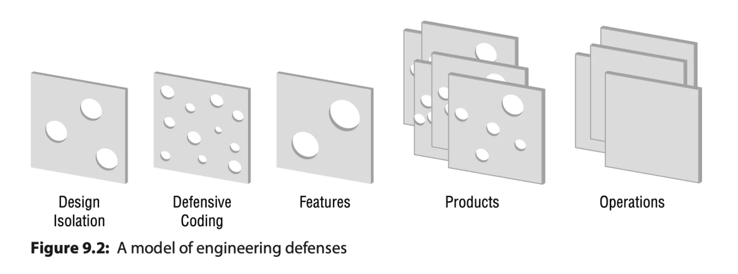
Swiss Cheese Model of Defenses
🤣

Slide 25
Defenses as a tradeoff space
■ Goal: protect, detect, respond
■ Goal: reduce likelihood or impact
■ Simple to complex
■ Reliable or probabilistic
■ Strong or weak (passwords vs. auth apps)
■ Chess move or checkmate
■ Proven or innovative (and of course, disproven)
■ Fail open or closed
■ Build or buy
■ One or many
■ Automated or manual
■ Effort to design, implement, maintain, or operate

Slide 26
More!

Slide 27
Scaling Threat Modeling (Ch 18)
New chapter goes from “threat model project”
to “threat model program”

Slide 28
Book details
Planned release February 2, 2027
Print, ebook
“Wherever fine books are sold”
Audiobook from Recorded Books
Audible, Spotify, Apple Books, Libby, hoopla digital...
Threatmodelingbook.com

Slide 29
Book tour plan
Planned release February 2, 2027
US tour being planned
Corporate
Non-profits
Advanced copies: Looking for reviewers (with platforms)
Get in touch! (info@shostack.org)

Slide 30
Thank you!

Slide 31

Questions?
Threatmodelingbook.com

Slide 32
Shostack + Associates
Supporting Materials
Don’t just understand security.
Build it in.

Slide 33
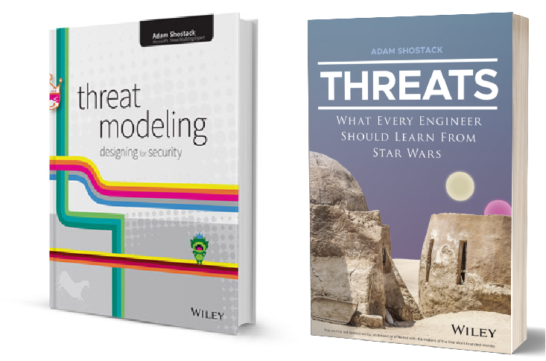
Free resources
shostack.org/resources
shostack.org/blog
youtube.com/c/Shostack
Books (Threat Modeling; Threats)
Linkedin Learning
* Books free at your library/various subscriptions;
Linkedin Learning via many employers

Slide 34
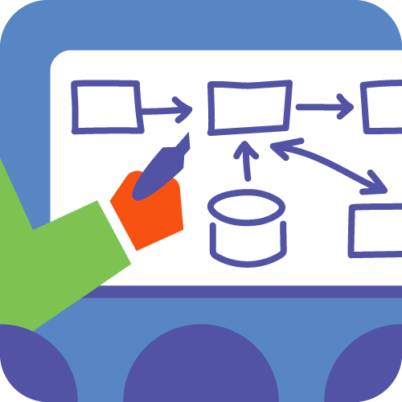

Commercial offerings
Training
  From under an hour to multi-day
  Live instruction or computer-based
  In person or distributed
  Private corporate courses
Accelerator
  Culture change, process design
Assessments + analysis

Slide 35

info@shostack.org shostack.org/contact

