Slide 1
Engineers are People Too
Adam Shostack
Microsoft
Notes:
Thanks for having me here today. As I looked over the program and some of the papers, I’m thrilled to see how much attention this community is paying to real people and what happens when we put our nice clever security tools into their hands. Today I want to talk with you about a missing link, and that is *HOW* we put our clever tools into their hands in a broad way. And that’s an element of software engineering. As you may know, here at Microsoft, we build a lot of software at a large scale…

Slide 2
Outline
Engineering in Large Projects
Threat Modeling
Usability Tools
Notes:
So I want to share some of that perspective from large scale software engineering, talk about a part of it where I spent three years, namely threat modeling, and then bring the lessons I learned there into thinking about engineering usability tools.

Slide 3
A Software Engineer’s Day
Solve customer problems
Write code
Build cool stuff
Change the world
Notes:
Our engineers here at Microsoft are here because they want to write software that lots of people are going to use to solve some problem. They want to build cool stuff, and they want to change the world with it. We ship software that ends up in installed in lots and lots of places, and we have hundreds of millions of people using our web, mail and IM services every day. And when you do that, you need to do a few more things…

Slide 4
A software engineer’s day (take 2)
Costs, Risks and Mitigations
Feature Requirements
Performance
Security
Privacy
Accessibility
Design
Geographical & Political concerns
Partner & Programmability
Compatibility
Internationalizability (dates)
Configurability
Manageability
Logging
Internationalizability (text handling)
Telemetry
Programmability
And oh yeah, write some code
Notes:
Unfortunately these are some of the things that come along with the scale at which we work. And they’re not unique to us. Everywhere you have engineers, they are making tradeoffs between various requirements in order to solve problems for their customers.
So that sets the stage for what I want to talk about today, and that is …

Slide 5
Outline
> Engineering in Large Projects
Threat Modeling
Usability Tools
Notes:
So I want to share some of that perspective from large scale software engineering, talk about a part of it where I spent three years, namely threat modeling, and then bring the lessons I learned there into thinking about engineering usability tools.

Slide 6
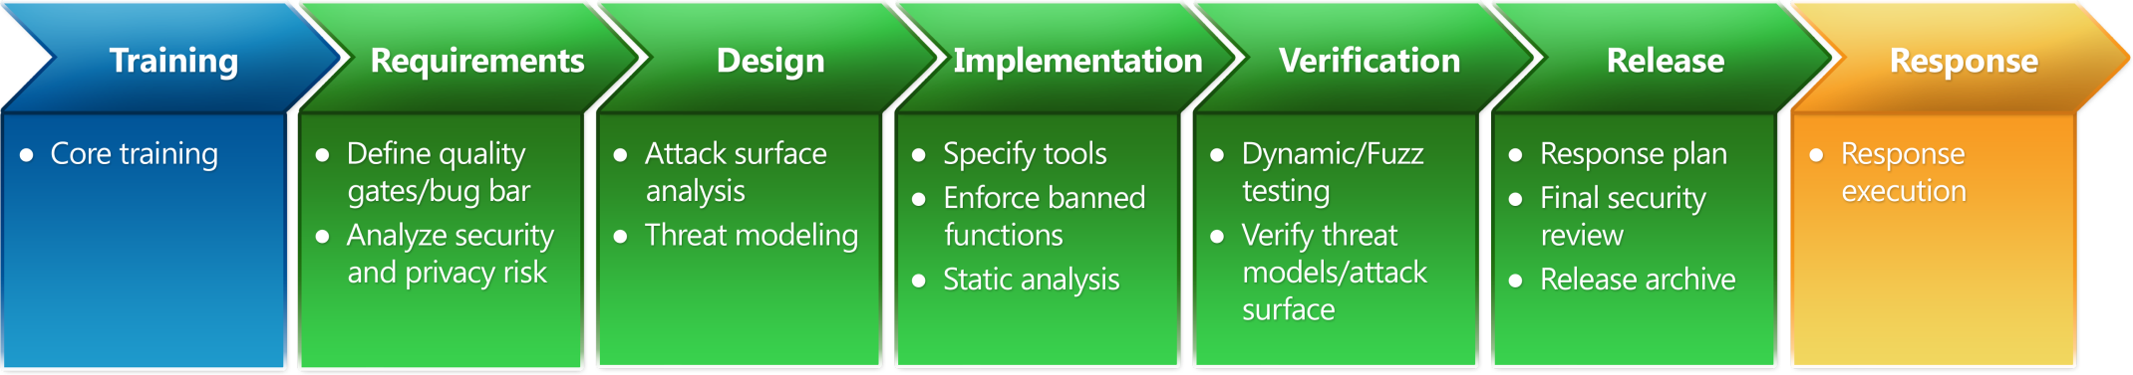
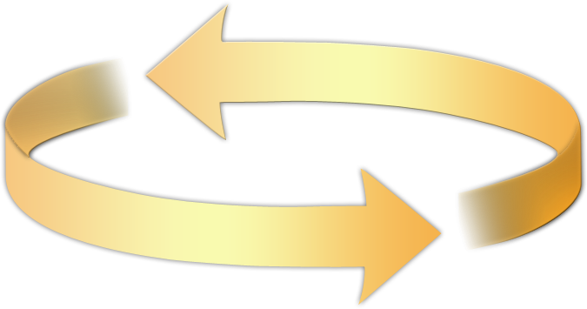
Security Development Lifecycle
Working to protect our users…
Education/Training
Process
Accountability
Administer and track security training
Guide product teams to meet SDL requirements
Establish release criteria and sign-off as part of FSR
Incident
Response (MSRC)
Ongoing Process Improvements
Notes:
Tools for management to secure our software

Slide 7
Orientation: Basic Concepts for Security Development Lifecycle
Secure design, including the following topics:
  Attack surface reduction
  Defense in depth
  Principle of least privilege
  Secure defaults
Threat modeling, including the following topics:
  Overview of threat modeling
  Design to a threat model
  Coding to a threat model
  Testing to a threat model
Secure coding, including the following topics:
  Buffer overruns
  Integer arithmetic errors
  Cross-site scripting
  SQL injection
  Weak cryptography
  Managed code issues (Microsoft .NET/Java)
Security testing, including the following topics:
  Security testing versus functional testing
  Risk assessment
  Test methodologies
  Test automation
Privacy, including the following topics:
  Types of privacy data
  Privacy design best practices
  Risk analysis
  Privacy development best practices
Privacy testing best practices

Slide 8
Outline
Engineering in Large Projects
> Threat Modeling
Usability Tools
Notes:
So I want to share some of that perspective from large scale software engineering, talk about a part of it where I spent three years, namely threat modeling, and then bring the lessons I learned there into thinking about engineering usability tools.

Slide 9
Threat Modeling
Analyzing the design of a system
  Engineers know their code and how it changes
Really, really hard for normal engineers to do
  Requires a skillset acquired by osmosis (“The security mindset”)
  Overcome creator blindness
  Extreme consequences for errors or omissions
  Training (version 1): “Think like an attacker”
And the consequences…

Slide 10
SDL Threat Modeling Tool
SDL TM Tool makes threat modeling flow better for a broader set of users
Main Approach:
  Simple, prescriptive, self-checks
Tool
  Draw threat model diagrams with live feedback
  Guided analysis of threats and mitigations using STRIDE
  Integrates with bug tracking systems
Notes:
Bug tracking systems? That’s an odd thing to mention

Slide 11
STRIDE Framework* for finding threats
Threat | Property we want
Spoofing | Authentication
Tampering | Integrity
Repudiation | Non-repudiation
Information Disclosure | Confidentiality
Denial of Service | Availability
Elevation of Privilege | Authorization
* Framework, not classification scheme. STRIDE is a good framework, bad taxonomy
Notes:
Note that this isn’t complete, but workable

Slide 12
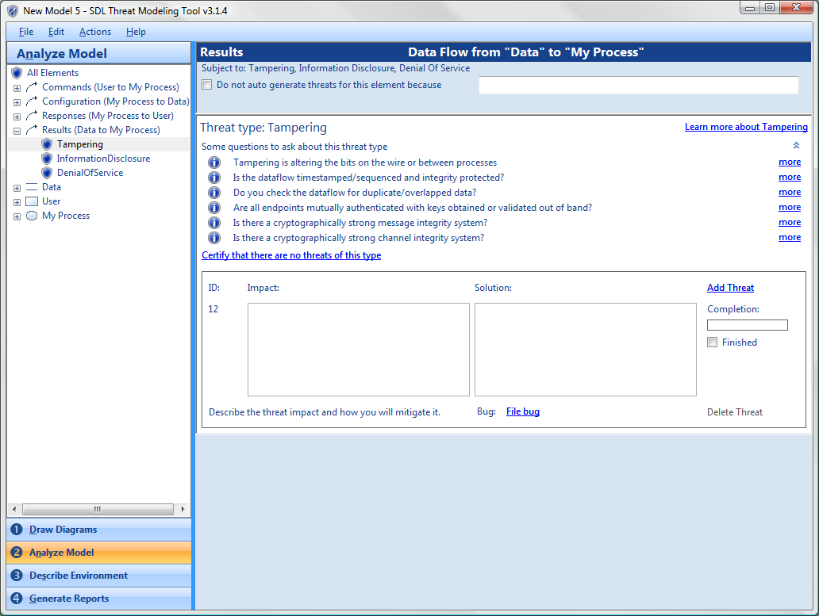
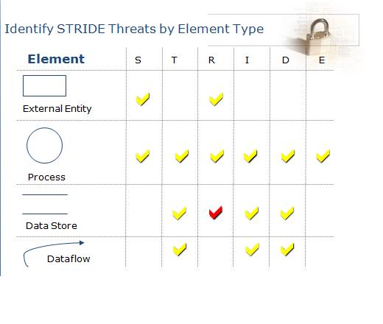
Find threats: Use STRIDE per element
Notes:
The red checkmark is a “sometimes” where if the data store is a log, then you have repudiation to worry about
Offers a balance between ability and challenge..

Slide 13

Flow & Engineering
“…the person is fully immersed in what he or she is doing, characterized by a feeling of energized focus, full involvement, and success…”
Elements of flow
  The activity is intrinsically rewarding
  People become absorbed in the activity
  A loss of the feeling of self-consciousness,
  Distorted sense of time
  A sense of personal control over the situation or activity
  Clear goals
  Concentrating and focusing
  Direct and immediate feedback
  Balance between ability level and challenge
Notes:
SDL TM Tool empowered people, but without increased challenge we lost flow

Slide 14
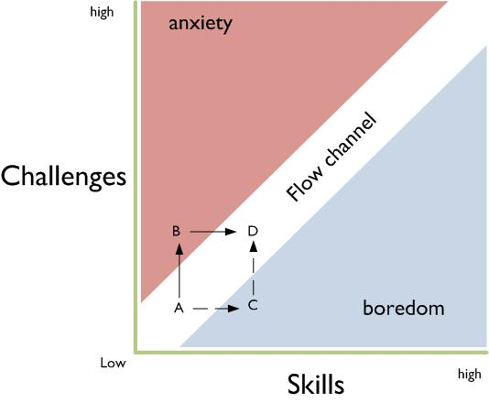
The Flow Channel

Slide 15
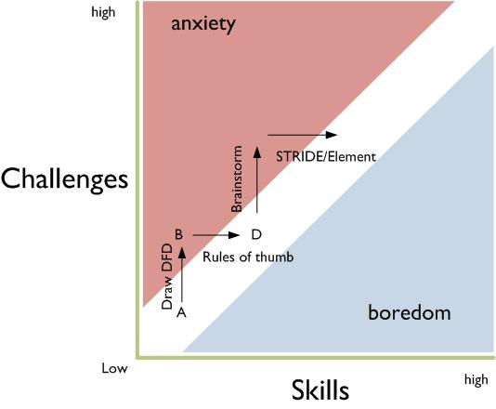
Flow and Threat Modeling

Slide 16
Outline
Engineering in Large Projects
> Threat Modeling (II)
Usability Tools
Notes:
So I want to share some of that perspective from large scale software engineering, talk about a part of it where I spent three years, namely threat modeling, and then bring the lessons I learned there into thinking about engineering usability tools.

Slide 17
2009 TM problem statement
Even with the SDL TM Tool…
Threat models often pushed to one person
  Less collaboration
  One perspective
  Sometimes a junior person
Meetings to review & share threat models
  Experts took over meetings
  Working meetings became review meetings
Notes:
Recap: Our previous problem is that we have a 30,000 engineers (dev/test/pm), of whom most are not security experts. All of them have the ability to make design decisions, and we need to give them a prescriptive method to do some security design analysis.

Slide 18
Elevation of Privilege:
The Threat Modeling Game
Inspired by
  Threat Poker by Laurie Williams, NCSU
  Serious games movement
Threat modeling game should be
  Simple
  Fun
  Encourage flow
Notes:
Not talking about how it works

Slide 19
Approach: Draw on Serious Games
Field of study since about 1970
  “serious games in the sense that these games have an explicit and carefully thought-out educational purpose and are not intended to be played primarily for amusement.” (Clark Abt)
Now include “Tabletop exercises,” persuasive games, games for health, etc
Notes:
Serious games support some business purpose

Slide 20
Elevation of Privilege is the easy way to get started threat modeling
Notes:
In the next 4 minutes I’m going to teach you what you need to know

Slide 21
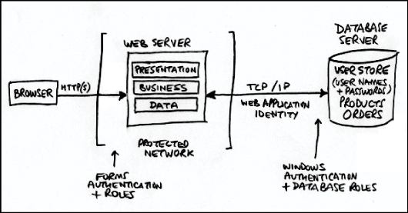
Draw a diagram
Notes:
Big complex systems that take years to write need diagrams to understand them.

Slide 22
How to play
Deal out all the cards
Play hands (once around the table)
  Connect the threat on a card to the diagram
  Play in a hand stays in the suit
Play once through the deck
Take notes:
  Player Points Card Component Notes
  _____ ____ ____ _________ ______________
  _____ ____ ____ _________ ______________
Notes:
Replaced standard suits with cards based on STRIDE
Come in a box like this
As you deal, explain the rules
Appoint a note-taker

Slide 23
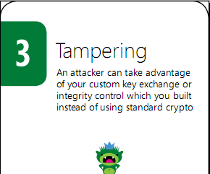
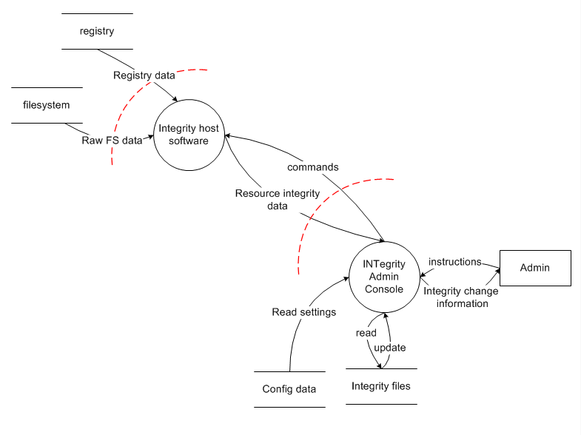
Example
Notes:
Let me explain this diagram before the cards
Alice plays 3 tampering
“An attacker can take advantage of your custom key exchange or integrity control which you built instead of using standard crypto”
As security people, we just know that’s something you don’t want to do

Slide 24
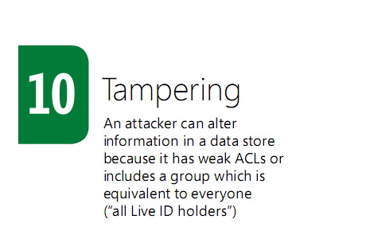
Bob plays 10 of Tampering
Notes:
Bob plays 10 of Tampering
“An attacker can alter information in a data store because it has weak ACLs”

Slide 25
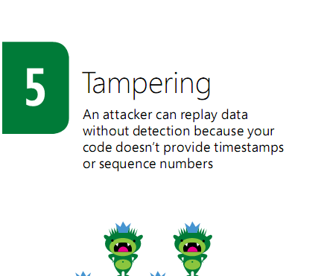
Charlie plays 5 of Tampering
Notes:
Charlie plays 5 of Tampering
“An attacker can replay data without detection because your code doesn’t provide timestamps or sequence numbers”

Slide 26
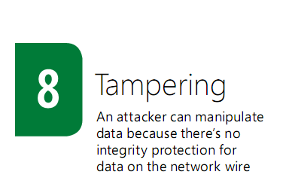
Dan plays 8 of Tampering
Notes:
Dan plays 8 of Tampering
“An attacker can manipulate data because there’s no integrity protection for data on the network”
Encryption isn’t enough! We need to integrity protect the data, too!
And so Bob wins this hand with the 10, and will start the next hand, selecting what suit to lead.

Slide 27
After the Elevation of Privilege Game…
Finish up
Count points
Declare a winner
File bugs
Notes:
What the winner gets
We’ve seen it work for people getting started around Microsoft and around the world

Slide 28
Elevation of Privilege is Licensed
Creative Commons Attribution
… Go play!
http://www.microsoft.com/security/sdl/eop/
Notes:
Creative Commons attribution license allows you to do what you want with the game

Slide 29
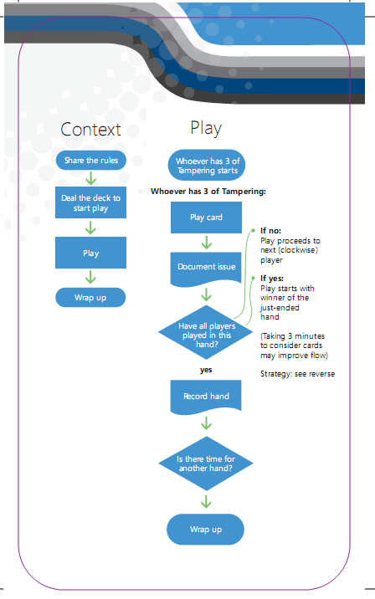
Why does the game work as a tool?
Attractive and cool
Encourages flow
Requires participation
  Threats act as hints
  Instant feedback
Social permission for
  Playful exploration
  Disagreement
Produces real threat models

Slide 30
Outline
Engineering in Large Projects
Threat Modeling
> Usability Tools
Notes:
So I want to share some of that perspective from large scale software engineering, talk about a part of it where I spent three years, namely threat modeling, and then bring the lessons I learned there into thinking about engineering usability tools. And I want to be clear-usability tools are not just bits of software, they can be checklists, they can be patterns, etc

Slide 31
Context
Engineers are smart & busy people
  Easy to forget how complex it is when it’s your job
  Hard to not admire the problem
No time in the schedule for UI design & test
We need to design flow experiences for engineers
Notes:
Usability is its own world much the way security is

Slide 32
Things we hear
“I’m an engineer, not a usability person”
“Can we sprinkle some security usability dust?”
“The problem is between the keyboard and chair”
“What are the top 5 things to make this usable?”
… all indicate a lack of flow in usability engineering efforts

Slide 33
Lots of Prior Work
Whitten, “Why Johnny Can’t Encrypt”
Yee, “User Interaction Design for Secure Systems”
Karp & Stiegler, “Including the User in Your Application Security Equation”
  Adds 6 properties to Yee’s Principles
Cranor, “A Framework for Reasoning About the Human in the Loop”
… and lots lots more
Yee’s Principles
Path of Least Resistance
Active Authorization
Revocability
Visibility
Self-awareness
Trusted Path
Expressiveness
Relevant Boundaries
Identifiability
Foresight
Notes:
I’d like to take a look at a real example of improving a feature

Slide 34
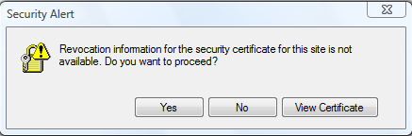
What’s the right thing?
Warning from old IE version:
  Uses the confusing term “revocation information”
  Does not explain why the user should be concerned
  Does not help the user decide
  Makes no recommendation to the user
Easy to get security experts arguing over revocation information
Notes:
This says “Revocation information for the security certificate for this site is not available. Do you want to proceed?”

Slide 35
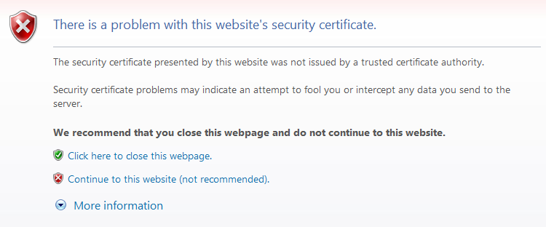
Much better!
How does this line up to Yee?
Path of Least Resistance (x)
Active Authorization ✓
Revocability (x)
Visibility ✓
Self-awareness ✓
Trusted Path (x)
Expressiveness (?)
Relevant Boundaries (?)
Identifiability (x)
Foresight (?)
Uses plain language (“there is a problem”)
Explains why the user should care (“may indicate an attempt to fool you or intercept data”)
Recommends an action (“close the webpage”)
Notes:
This is better, but how can we engineer to better, rather than stumble towards it?
We tried applying Yee’s Principles, but they seem very high level when you’re working through a dialog. They appear to target the application or even operating system design as a whole, rather than a feature. We have lots of features and we need to ensure that each one works well. This is one of our lessons out of SDL—get the tools to the engineers
Ironically, usability literature is not all that usable – its Big & complex with lots of jargon

Slide 36
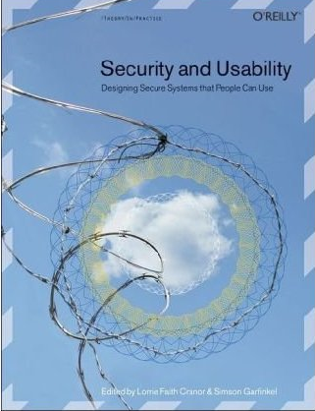
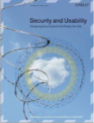
The Flow Channel
Notes:
Clear goals
Balance between challenge and ability
Feedback

Slide 37
What do people want?
Simple and actionable
We’re working on guidance for warnings and prods
  Simple
  Concrete
  Easy to compare version A to B
How to get there? Ensure each:
  Must involve a user choice
  Clearly lays out the issue, why it matters
  Provides actionable guidance
  Is validated from a UI & security perspective
Notes:
Warnings alert a user to potential danger and get the user’s consent to proceed
Prods urge a user to interrupt their current task and take action to strengthen their security
Notice the resemblance to factors for flow
Let’s dig into how this works. What I’m going to show you is excerpted from internal presentations and training, and so the “you” is a software engineer for a little while.

Slide 38
Required? Can you just be safe?
Is your security UX…
When possible, automatically take the safest option and, optionally, notify the user that other options are available
Rather than forcing a trust decision, Office 2007, 2010 applications show safe content and give a non-blocking notification that additional, possibly unsafe, content is available.
Guidance Example

Slide 39
Clearly lay out the Issue
Does your Security UX…
Provide the user with all the information necessary to make the right decision:
  Where is this decision coming from?
  What is the security risk of getting the decision wrong?
  What are their options?
  What do we recommend they do?
  What steps should they take to make the decision?
  What information should they factor in?
  What will happen when
  they choose each option?
Guidance Example

Slide 40
What to fix first?
Tool to prioritize and make tradeoffs between bugs:
Main Criteria | Supporting criteria
Even a security or privacy expert couldn’t make the right decision in a scenario which is on the box or which an attacker could invoke | Misleading security info or indicators (includes no security indicator)
Only a security or privacy expert could make the right decision | No/bad/insufficient guidance
Anyone could make the right decision, but they’d have to really be paying attention. | Experiences that lack recommendation, which habituate users, or which are randomly different than other TUXes
Importance
Notes:
After explaining bug bar: now, some people look at this and say that the pris are too low, that a 3 should be a 2, and I agree with that; at the same time there’s others who say “wow, we’re going to have a lot of P1 and P2 bugs, and won’t be able to get to the P3s.” Depending on the product, they’re all correct.
So what’s right is what’s right for an organization to get started, and there, the looser bar is easier to adopt, develops flow
With that, let me move to the overall topic of this presentation, how to patch social engineering

Slide 41
Usability tools for Engineers
Principles and Guidance are both worthwhile research areas
  “One page” guidance is hard to find
  Scientists and engineers may weight them differently

Slide 42
Outline
Engineering in Large Projects
Threat Modeling
Usability Tools
Notes:
So I want to share some of that perspective from large scale software engineering, talk about a part of it where I spent three years, namely threat modeling, and then bring the lessons I learned there into thinking about engineering usability tools.

Slide 43
A Software Engineer’s Day
Solve customer problems
Write code
Build cool, usable and secure stuff
Change the world

Slide 44
Call to action
Study how engineers work and their needs
Experiment with and test guidance
  Use them, improve on them, or replace them
Spread the word that engineers are people too
  Need usable approaches to usability engineering
Notes:
* Need usable approaches to usability engineering
* Experiment with our guidance—use it in your projects or create more & test it
* Make a game

Slide 45
Questions?

Slide 46

© 2010 Microsoft Corporation. All rights reserved. Microsoft, Windows, Windows Vista and other product names are or may be registered trademarks and/or trademarks in the U.S. and/or other countries.
The information herein is for informational purposes only and represents the current view of Microsoft Corporation as of the date of this presentation. Because Microsoft must respond to changing market conditions, it should not be interpreted to be a commitment on the part of Microsoft, and Microsoft cannot guarantee the accuracy of any information provided after the date of this presentation.
MICROSOFT MAKES NO WARRANTIES, EXPRESS, IMPLIED OR STATUTORY, AS TO THE INFORMATION IN THIS PRESENTATION.

