Slide 1
The CRA: A Cloud-Scale Change to Engineering
Adam Shostack
OWASP Global Appsec
November 2026

Slide 2
“A cloud-scale change”?
“Cloud” was transformational
  Deployment velocity
  Deployment patterns
    Cloud-native (S3, Lambdas, etc) replacing VMs in the cloud
    Cloud-native with new and better enforced boundaries
CRA will define the next ten years
  In good ways (security) and bad (paperwork)

Slide 3
Summary and key points
The CRA imposes dramatic changes on products available in Europe
Many OWASP projects could become more useful
  Many OWASP projects have customers/users who are impacted
  Some OWASP projects can support CRA requirements (Eg, “verification standards” “threat modeling”)
Some projects could be impacted
  All OWASP projects need to be aware of the effect of accepting €
  A few OWASP projects will have a new “open source steward”
  Some (“damn vulnerable”) are probably not directly impacted
CRA might affect your employer, too.

Slide 4











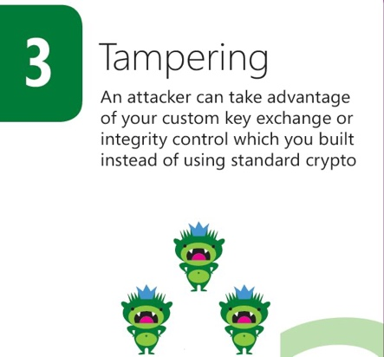

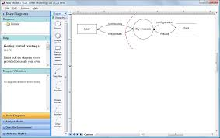



About
Don’t just understand security.
Build it in.

Slide 5
The CRA
European Legislation, the Cyber Resilience Act
REGULATION (EU) 2024/2847 OF THE EUROPEAN PARLIAMENT AND OF THE COUNCIL (23 October 2024)*
“Horizontal cybersecurity requirements for products with digital elements”
Big, complex law
  123 pages in 71 articles, 8 annexes in the law
  84 pages of official guidance
Disclaimer:
  The CRA is a big, complex law; I’m not a lawyer. You might need legal advice!
  Almost everything in this presentation is paraphrased (for space reasons)
Notes:
https://eur-lex.europa.eu/legal-content/EN/TXT/HTML/?uri=OJ:L_202402847

Slide 6
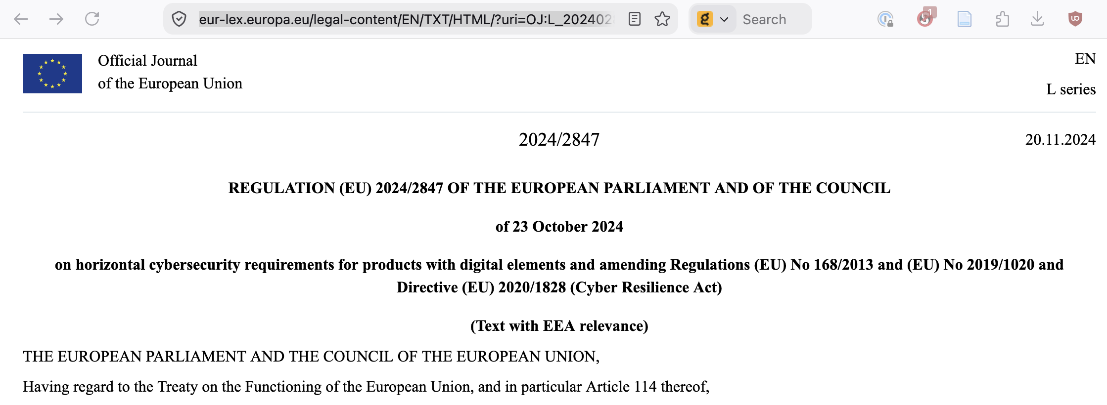

Haha, no
The actual date in the EU Journal is different
( 10 December 2024)
Notes:
See https://digital-strategy.ec.europa.eu/en/policies/cyber-resilience-act for the official start date.

Slide 7
What is the CRA?
The law in Europe as of 2024, not fully in effect yet.

Slide 8
Applies to any “economic operator” who:
Manufactures products with digital elements and places them on the EU market — including hardware with embedded software and standalone software products
Imports products from non-EU manufacturers and places them on the EU market under their own name or trademark
Distributes products on the EU market without altering them
Open-source stewards who systematically provide free/open-source software intended for commercial use

Slide 9
“Products with digital elements”
Any technology product and its remote data processing solution, that has a direct or indirect data connection to a device or network:
  Consumer IoT devices (smart home, wearables, routers)
  Industrial hardware with network connectivity
  Standalone software applications (desktop, mobile, server)
  Apps distributed through app stores for mobile phones and smart TVs
  Operating systems and hypervisors
  Software components and libraries placed on the market
  Cloud-connected devices where the manufacturer controls the backend
Not “a product with digital elements”:
  A website (by itself)
  Medical devices (regulated separately)
  Open source (“it’s complicated”)
  Not “placed on the market”

Slide 10
Product classes
Default: all in-scope products not listed in Annex III or IV.
Important — Class I (Annex III, Class I) — products posing a significant cybersecurity risk, such as identity management software, browsers, password managers, and general-purpose operating systems.
Important — Class II (Annex III, Class II) — higher-risk products including hypervisors, TPMs, industrial automation software, and smart meter gateways.
Critical (Annex IV) — the highest-risk products, including hardware security modules (HSMs), smart cards, and hardware devices with security boxes.

Slide 11
Fines up to 2.5% of global revenue
“Failing to meet essential cybersecurity requirements”
“Violations relating to conformity assessment, technical documentation...”
Not reporting actively exploited vulns (2%)

Slide 12
In partial effect now!
June 11, 2026 “notification of conformity assessment bodies”
Sept 11, 2026 “reporting obligations”
Dec 11, 2027 “fully applicable”
Other laws, like NIS2 may apply to cybersecurity. (Different dates.)

Slide 13
Many terms don’t mean what you expect
Specific requirements triggered by a “substantial modification”
  “a change alters the level of cybersecurity risk, and where such altered or additional risk has not been considered by the manufacturer in its risk assessment” (Guidance, 104)
  “even limited or seemingly minor new functionalities may introduce significant cybersecurity risks that impact compliance with the essential requirements [of the CRA]. The assessment of substantial modification should therefore not be based on the scale or complexity of the change” (Guidance, 107, emph added)

Slide 14
Terms don’t mean what you expect (2)
“Risk management”
  “In organisational risk management, risks are commonly evaluated against acceptance criteria derived from the organisation’s internal objectives or risk appetite. By contrast, under the CRA, residual cybersecurity risk should be assessed ... ensures an appropriate level of cybersecurity based on the risks [to users]”
  “the manufacturer’s internal risk tolerance, commercial strategy or mere cost considerations are not relevant in determining whether risks have been addressed...”
  “The CRA does not provide for the transfer of cybersecurity risk or responsibility to users or third parties to compensate for shortcomings in product design...”
  (Guidance 157-161)

Slide 15
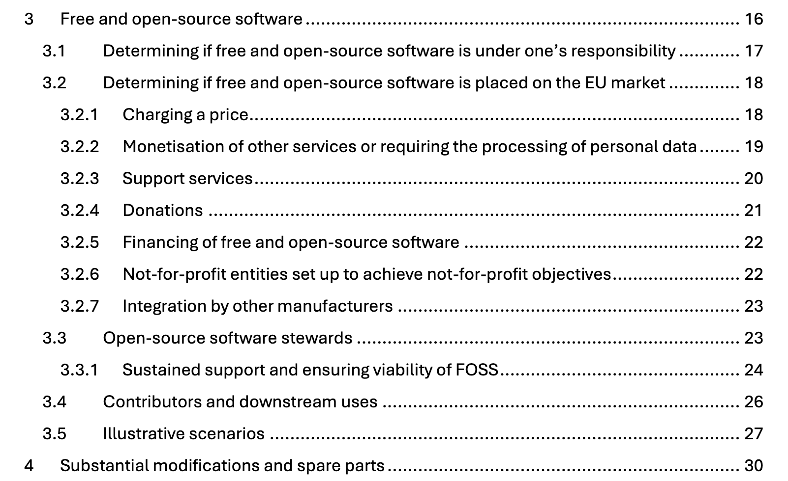
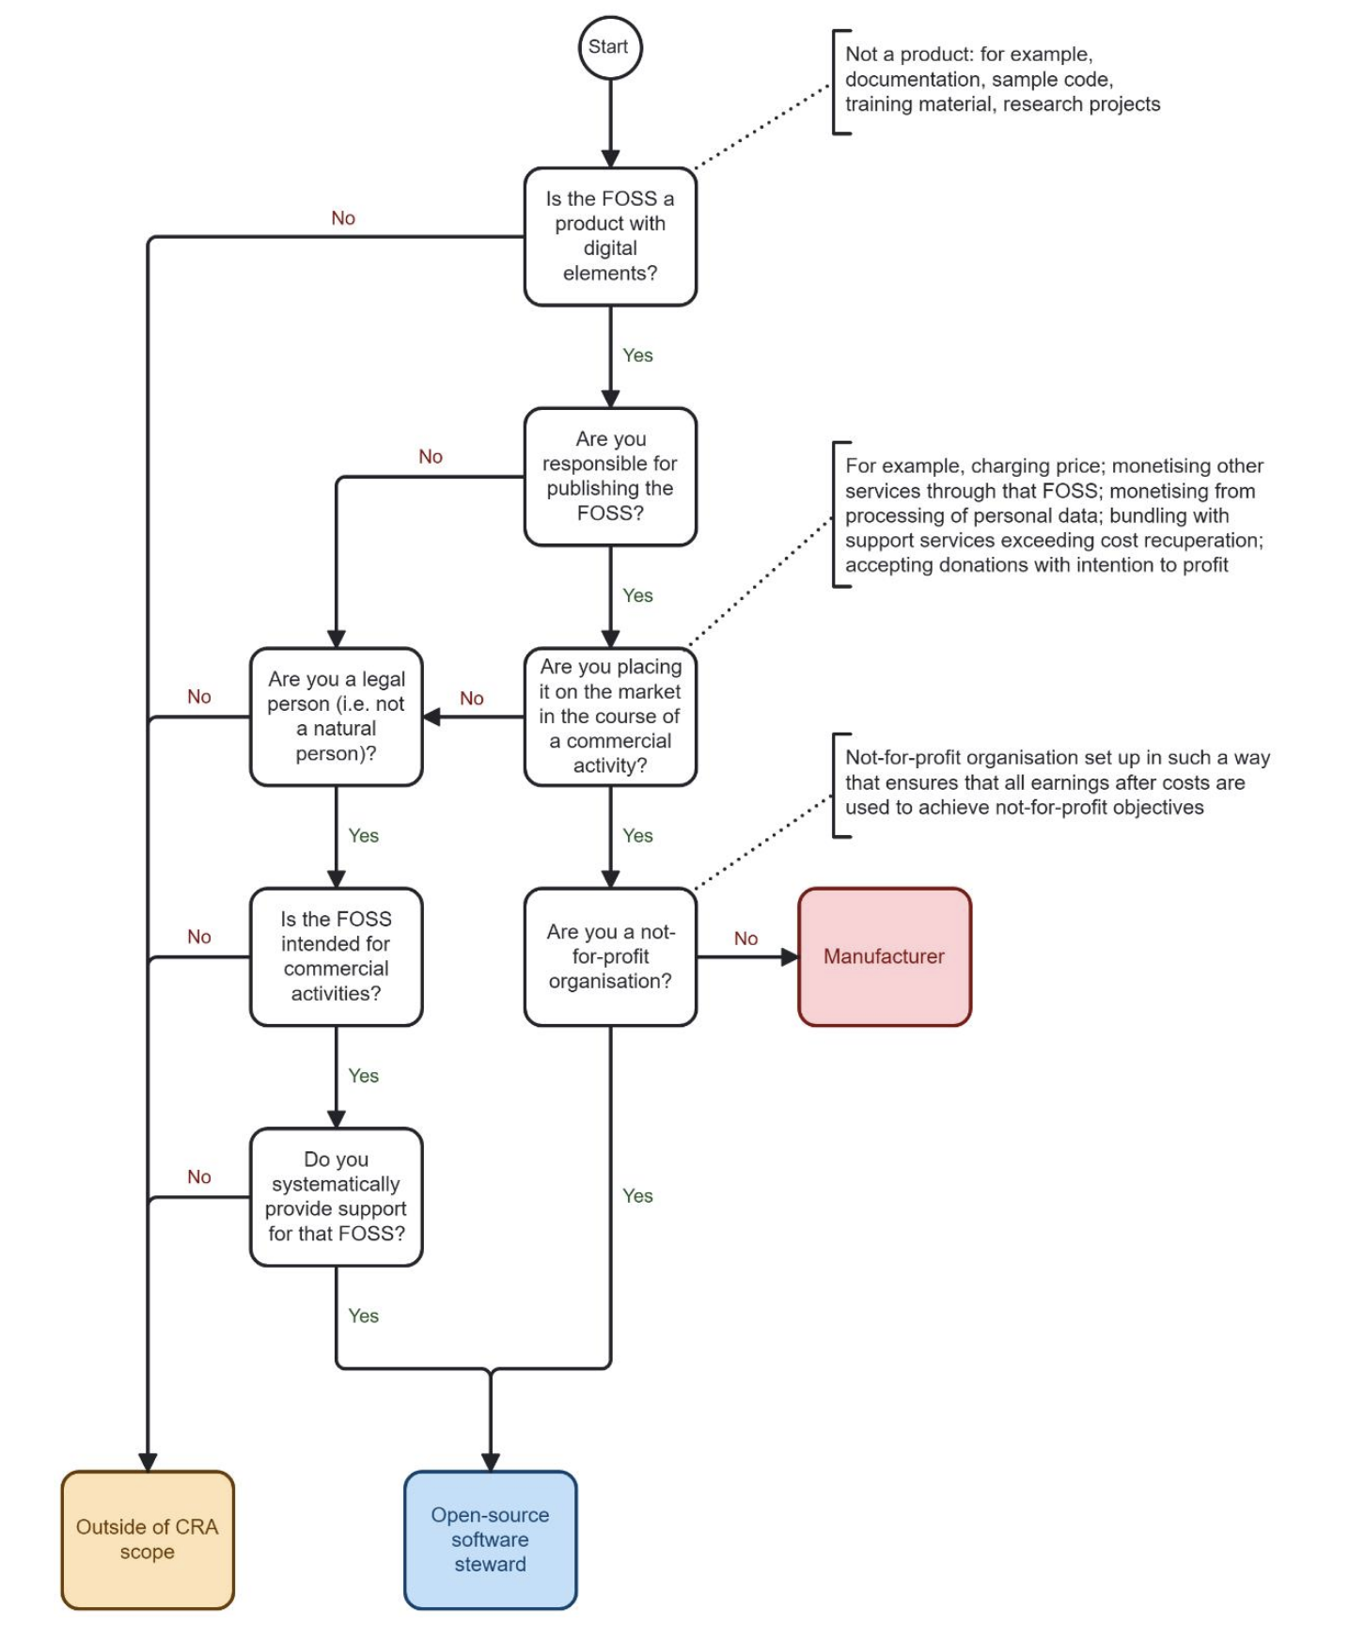
Is open source impacted?
The CRA guidance has 15 pages on that.
With a flowchart.

Slide 16
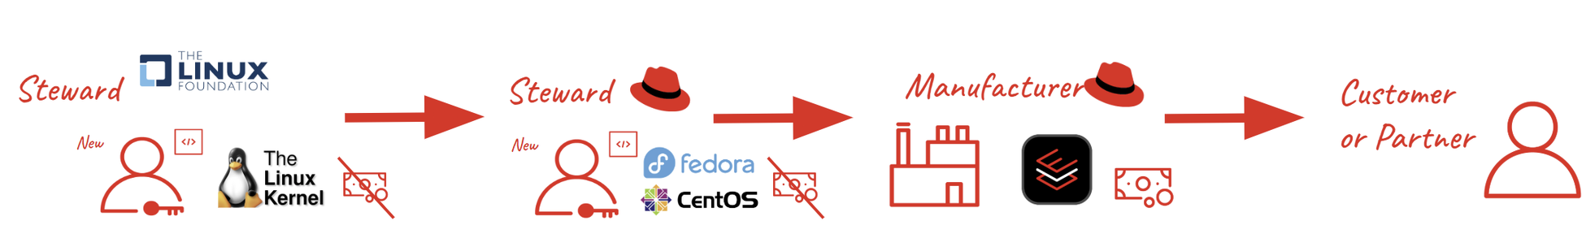
Impacted open source gets “Stewards”
New type of legal actor to help with administrative overhead
Eg, RedHat, “EU Cyber Resilience Act Stewardship Guidelines for Red Hat Supported Open Source Projects”
  18 pages as a PDF
  25 minute read
Notes:
https://access.redhat.com/security/eu-cyber-resilience-act-stewardship-guidelines

Slide 17
What does the CRA require?

Slide 18
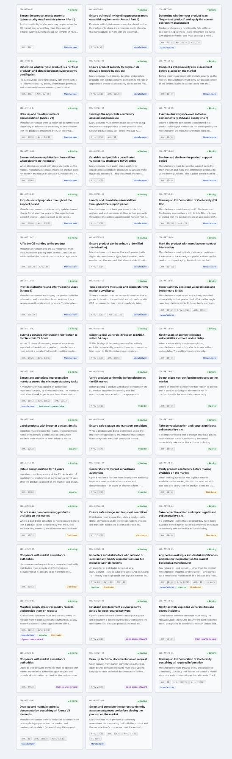
The CRA has lots of requirements!
“CRA Compliance Hub” lists 47!
“Cybersecurity risk assessments”*
Documentation
  Create, maintain tech docs (Annex VII)*
  User docs (Annex II)*
  Create an EU declaration of conformity
Vulns
  Have a coordinated vuln disclosure process
  Report exploited vulns to ENISA
Defined support periods, generally 5+ years
  Including free security updates
Covers products and “remote data processing”
Extra requirements for “Important” or “Critical” products
  Including “more stringent conformity assessments”
* = more on upcoming slides

Slide 19
Cybersecurity risk assessments mandated
“The manufacturer is required to carry out a cybersecurity risk assessment in accordance with Article 13(2) of the CRA in order to determine, on the basis of the intended purpose and reasonably foreseeable use of the product with digital elements, which of the essential requirements set out in Part I of Annex I are applicable to that product with digital elements, and how those requirements are implemented.” (Guidance, para 33)
Even for products already on the market!
  There are exceptions but they probably don’t allow avoid a risk assessment

Slide 20
Risk assess: Part I, Annex I (abridged, 1/2)
be made available on the market without known exploitable vulnerabilities;
be made available on the market with a secure by default configuration (...)
ensure that vulnerabilities can be addressed through security updates (...)
ensure protection from unauthorised access by appropriate control mechanisms, including but not limited to authentication, IAM systems, and report on possible unauthorised access;
protect the confidentiality of data, such as by encrypting relevant data at rest or in transit
protect the integrity of data,
process only data, that are relevant and limited to what is necessary for the intended purpose of the product (data minimisation);

Slide 21
Risk assess: Part I, Annex I (abridged, 2/2)
protect the availability ... also after an incident, including through resilience and mitigation measures against denial-of-service attacks;
minimise the negative impact by the products on the availability of services provided by other devices or networks;
be designed ... to limit attack surfaces, including external interfaces;
be designed ... to reduce the impact of an incident using appropriate exploitation mitigation mechanisms and techniques;
provide security related logs
provide a way to securely and easily remove all data and settings

Slide 22
Instructions for users (Annex II)
How to report a vuln (“CVD”)
“any known or foreseeable circumstance, related to the use of the product with digital elements in accordance with its intended purpose or under conditions of reasonably foreseeable misuse, which may lead to significant cybersecurity risks;” (“transferred risks”?)
Detailed instructions on how to:
  Use it securely
  how security-relevant updates can be installed;
  the secure decommissioning
  how to turn off automatic installation of security updates
  ... and more

Slide 23
Documentation (abridged from annex VII)
a description of the design, development and production of the product with digital elements and vulnerability handling processes, including:
  information on the design and development, including drawings... and a description of the system architecture
  vulnerability handling ... and distribution of updates;
  information and specifications of the production and monitoring processes and the validation of those processes;
an assessment of the cybersecurity risks
information that was taken into account to determine the support period
a list of the harmonised standards applied in full or in part
reports of the tests carried out and of the vuln handling processes
a copy of the EU declaration of conformity;
SBOM
All archived for ten years!

Slide 24
Risk assessment requirements
(Commentary)

Slide 25
The CRA “risk assessment” means threat model
The CRA guidance contains lots of “in contrast” (already covered)
IMO, they should have said they mean “Threat model it!”
  Design flaws must be fixed
  Risk accept/transfer are not acceptable when you could fix the design
Not just “what are we working on,” dependencies too
Also applies to existing products
  “this Regulation does not necessarily require ... be redesigned.”
  “The manufacturer is required to carry out a cybersecurity risk assessment”

Slide 26
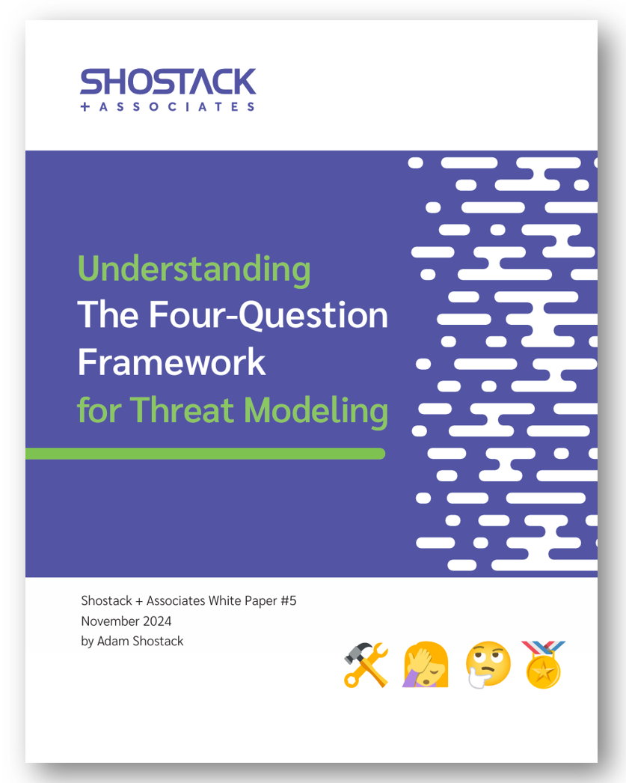


How do we threat model?
Shostack.org/whitepapers
Four Question Framework
  What are we working on?
  What can go wrong?
  What are we going to do about it?
  Did we do a good job?
OWASP TM Project, Threatmodelingmanifesto.org
For CRA compliance
  Applying a harmonized standard
  Breadth and depth of answers

Slide 27
The CRA in the TM Four Question Frame
“What are we working on?”
CRA Answer | Comments
Products with digital elements | Regular and 3 classes of important/critical
TM dependencies | Open source isn’t exempted
 | Even if no one analyzed it before
TM remote data processing | Boundary is mandatory (Guidance 168-170)
TM products already shipped | May require a redesign to continue “placing on the market”
Any substantial modification... | Defined by change in risk, not code. See Guidance 104-107

Slide 28
“What can go wrong?”
CRA Answer | Comments
The entire CRA | “do not pose cybersecurity risks to persons and organisations”
Annex I | 10 requirements (“appropriate level of security based on the risks”, and lists defenses, leaving the threats sort of implicit)
 | Annex VII.3 requires “an assessment of the risks”
Dependencies | Not exempted
Remote data processing | Consider what happens if the RDP is popped

Slide 29
“What are we going to do?”
CRA Answer | Comments
Remove risks | Appropriate level of security for intended purpose, foreseeable use
 | Not “organisation’s internal objectives or risk appetite.”
 | “mere cost considerations are not relevant” (G 158)
Remote data processing | Consider what happens if the RDP is popped
By “remove risks” I believe they mean “implement technical changes to prevent the threat.”

Slide 30
“Did we do a good job?”
CRA demands breadth, depth and polish!
CRA Answer | Comments
Declaration of conformity(!) | Annexes V, VI, VII
 | External review for Important, Critical products
Annex VII | List of harmonized standards applied Threat model and other technical documentation
 | Even if no one analyzed it before

Slide 33
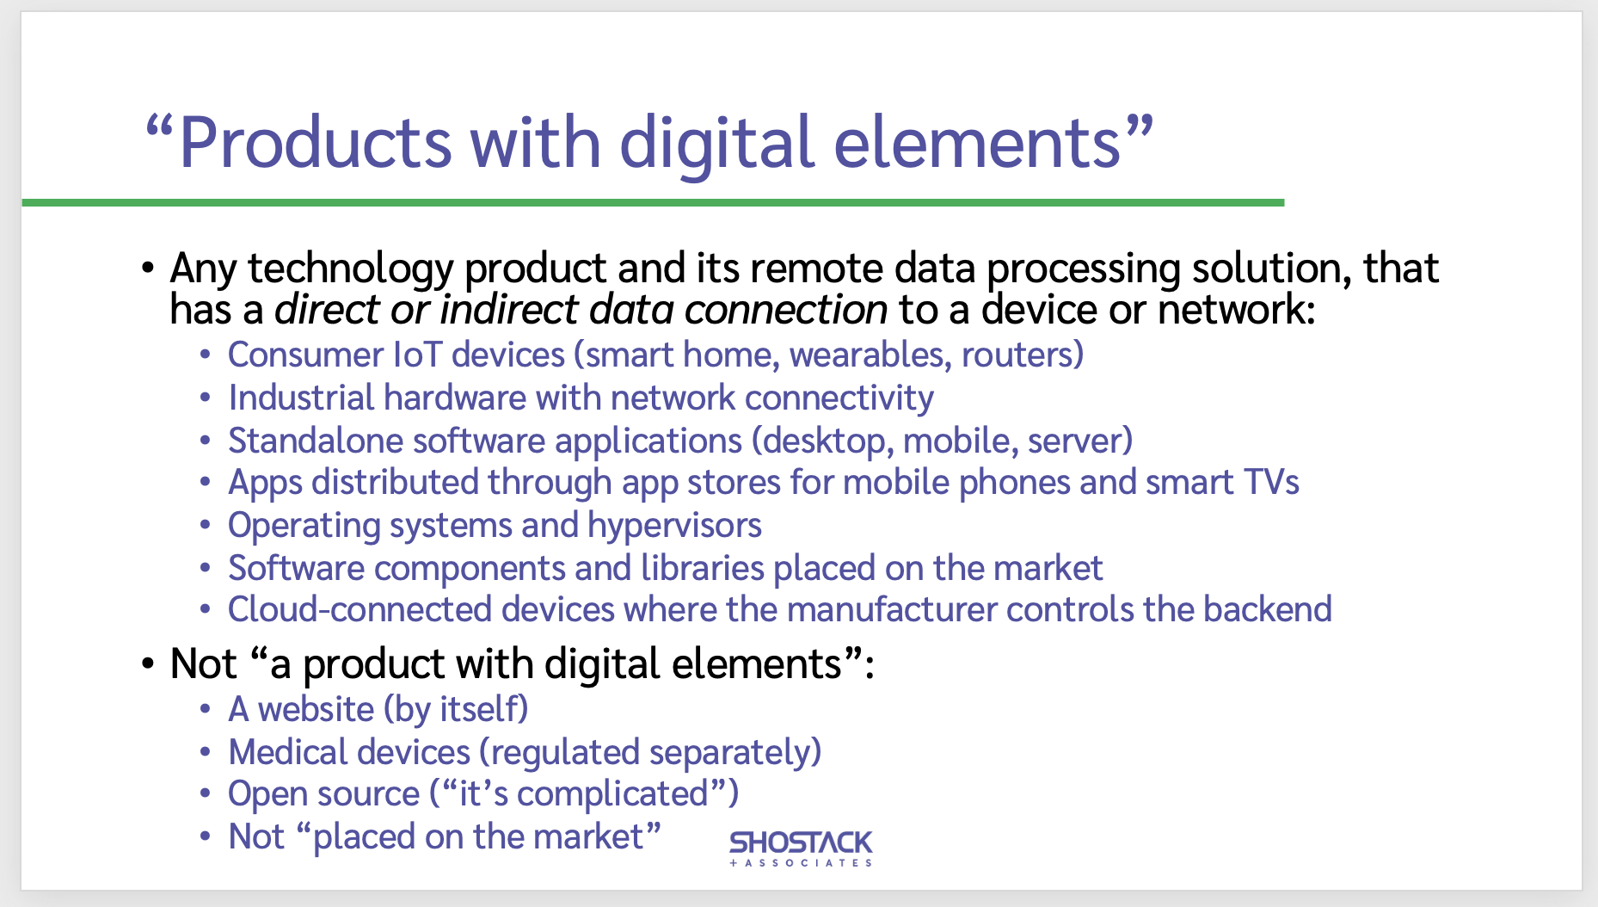
All products with digital elements
All products
Extra requirements for “Important Products” in various classes
  IAM, EDR, SIEM, Solarwinds
  Browsers
  Password managers
  Operating systems
  Routers + net management
  Smart meters

Slide 34
ENISA Secure by Design + Default Playbook
Formally focused on principles of secure by design, not CRA
July 2026
80 Pages
https://www.enisa.europa.eu/sites/default/files/2026-07/ENISA_Secure_By_Design_and_Default_Playbook_v1.pdf

Slide 35
OWASP + CRA

Slide 36
OWASP can serve CRA-affected
Strategy: OWASP should help organizations comply with CRA
Project opportunities
Intra-project linkages
OWASP partnerships
  OWASP is a member of the Eclipse ORCWG
  OWASP is a “Category C Liaison Organization” with ISO/IEC
  OWASP has provided feedback to ENISA on CRA docs

Slide 37
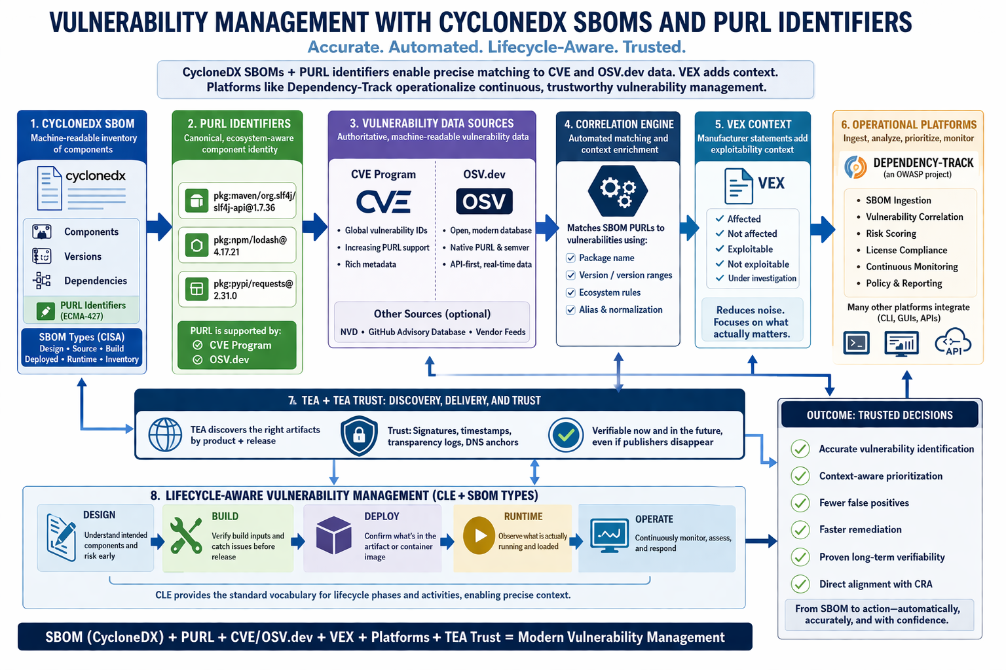
Map by Ollie Johansson
Notes:
https://github.com/oej/tea-trust-architecture/blob/main/docs/owasp-story/vulnerability-management.png ; https://github.com/CycloneDX/transparency-exchange-api/tree/main/presentations/oej

Slide 38
Call to action: Every project
Ask “how can our project help others be CRA-compliant”
  Maybe a guide doc “Project X and CRA”?
  A tool mode --cra that checks against the requirements in Appendix A?
If you have a CRA-aware member, review the project
Otherwise, find a CRA expert to engage with the project
Should OWASP have a CRA project? Yes and no
  My take is almost every project is a CRA project now
  Some projects also have CRA requirements

Slide 39
Call to action: Learning projects
Eg, Damn vulnerable, Goats and Juice Shop
Does your project have a CRA mapping?
  What requirements do you cover?
  What don’t you cover? Is that documentation or roadmap?

Slide 40
Call to action: OWASP “Central”
These are legal questions and deserve lawyer answers
  Is OWASP a steward?
  Does it have obligations? Do projects?
@Maxum @Olle E. Johansson and @Starr Brown are leading

Slide 41
Resources
Resource | Publisher | URL
The law | The EU | https://eur-lex.europa.eu/legal-content/EN/TXT/?uri=CELEX%3A32024R2847
Official Guidance | The EU | https://digital-strategy.ec.europa.eu/en/library/commission-publishes-new-guidance-support-timely-cyber-resilience-act-implementation
FAQs | Open Reg. Compliance WG (Eclipse Foundation) | https://cra.orcwg.org/ (Includes nice HTML version of the official guidance)
Overview | Safecode | https://safecode.org/blog/cra-reporting-begins-11-september-2026-manufacturers-need-to-prepare-now/
Intros, overviews | CRA Compliance Hub | https://eucybersecurity.org/en/cra-overview

Slide 42

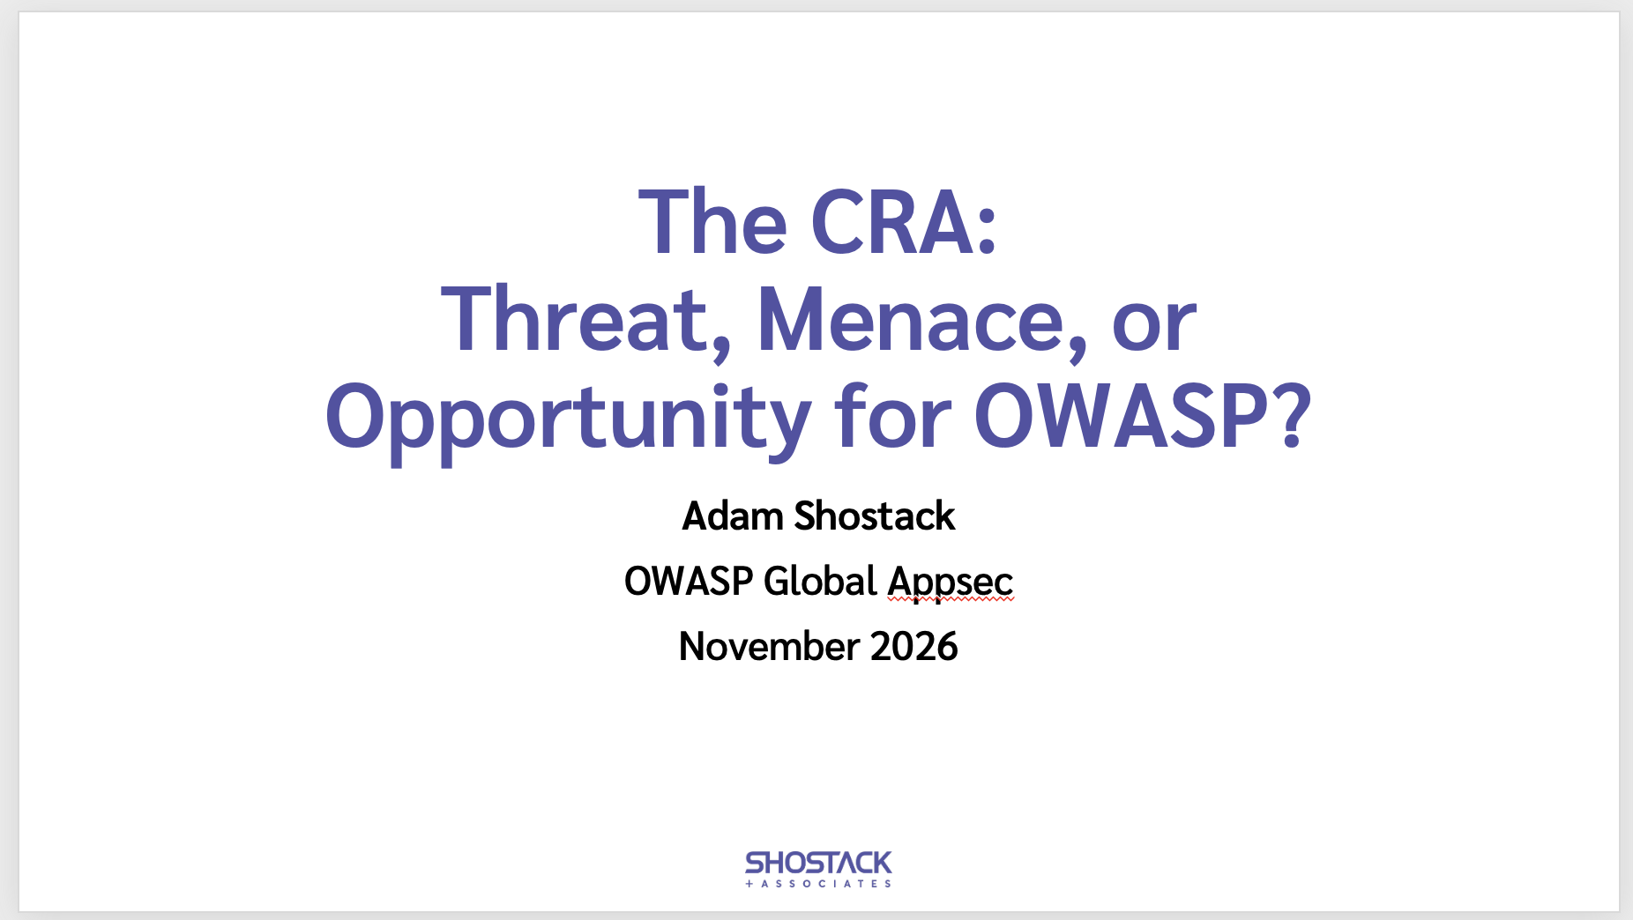
The CRA: Threat, Menace or Opportunity?
OWASP Global Appsec • Nov 2026
Questions?
Slides:
Shostack.org/blog

Slide 43
Shostack + Associates
Supporting Materials
Don’t just understand security.
Build it in.

Slide 44

Free resources
shostack.org/resources
shostack.org/blog
youtube.com/c/Shostack
Books (Threat Modeling; Threats)
Linkedin Learning
* Books free at your library/various subscriptions;
Linkedin Learning via many employers

Slide 45


Commercial offerings
Training
  From under an hour to multi-day
  Live instruction or computer-based
  In person or distributed
  Private corporate courses
Accelerator
  Culture change, process design
Assessments + analysis

Slide 46

info@shostack.org shostack.org/contact

Slide 47
Thank you!

